Slide 1
Agile / Scrum Methodologies
Presentation by Team 3
Shreya Shreya
Anvesha Tiwary
Sejal Khadkikar

Slide 2
Content
Introduction to Agile
Agile Frameworks
Agile Manifesto and 12 Principles
Implementation Strategies
Measuring and Scaling agile
Comparing Agile & other Frameworks
Final Thoughts and Key Takeaways & References

Slide 3
01
Introduction to Agile

Slide 4
Agile Essentials
AGILE = CONCURRENCE + COLLABORATION + COMMUNICATION + CONTINUOUS
Emerged in the early 2000s to speed up software delivery.
Origin
Defined by the Agile Manifesto in 2001 by 17 developers.
Evolution
Core Principles
Prioritizes people, deliver functional s/w, customer cooperation and flexibility.
Key Concepts
Emphasizes iterative development & continuous plan adaptation.

Slide 5
Overview of Agile Methodology
BASICS OF AGILE
WHAT IS AGILE?
HOW AGILE WORKS?
AGILE EXECUTION AND ADAPTATION
Time boxed iterative approach to software development
Collaborate with customers & create user stories
Start executing based on priority : build, iterate and collect feedback
breaks down work into prioritize user stories
Estimate effort for each and determine relative time need
Update the plan on the go based on feedback & outcome
ensures continuous delivery through short cycle (iteration)
Prioritize User story, focusing on critical features first

Slide 6
02
Agile Frameworks

Slide 7
Key Agile Framework
SCRUM
KANBAN
Fixed-length iterations (Sprints)
Defined roles (Scrum Master, Product Owner, Development Team)
Regular ceremonies (Planning, Daily Standups, Reviews, Retrospectives)
Focus on workflow management
Continuous delivery without fixed iterations
Emphasizes visualizing work and limiting work in progress
XP
Lean
Technical excellence and customer involvement
Practices include pair programming and test-driven development
Frequent releases for responsiveness
Inspired by lean manufacturing principles
Focuses on eliminating waste
Maximizes value through efficiency

Slide 8
Key Agile Framework
SCRUM
Fixed-length iterations (Sprints)
Defined roles (Scrum Master, Product Owner, Development Team)
Regular ceremonies (Planning, Daily Standups, Reviews, Retrospectives)
User Stories
Emphasizes teamwork, transparency, and adaptability
usually lasting 1- 4 weeks to deliver manageable increments of the project.
daily standup and sprint reviews to align team & track progress
Quick adaptation to changing requirements
Transparent communication, prioritize product backlog
Collaboration and Adaptability
Sprints
Regular Meetings
Efficient
Customer Centric

Slide 9



SCRUM ROLES
PRODUCT OWNER
Responsible for maximizing the value of the product
SCRUM MASTER
Facilitates Scrum processes and shields the team from distractions.
DEVELOPMENT TEAM
A cross-functional group that delivers the product incrementally.

Slide 10
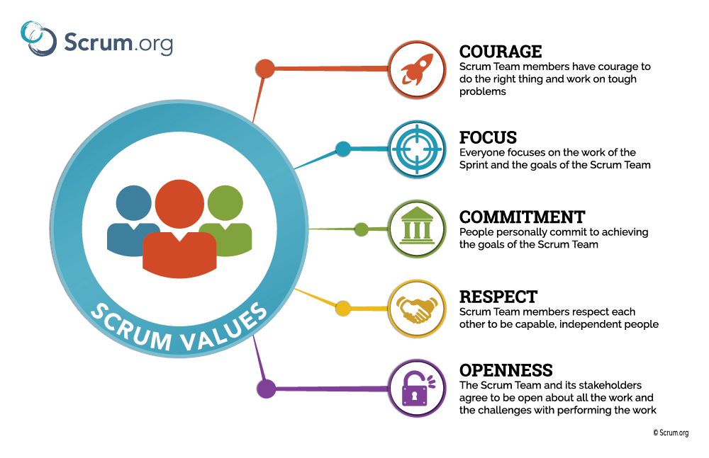
SCRUM VALUES

Slide 11
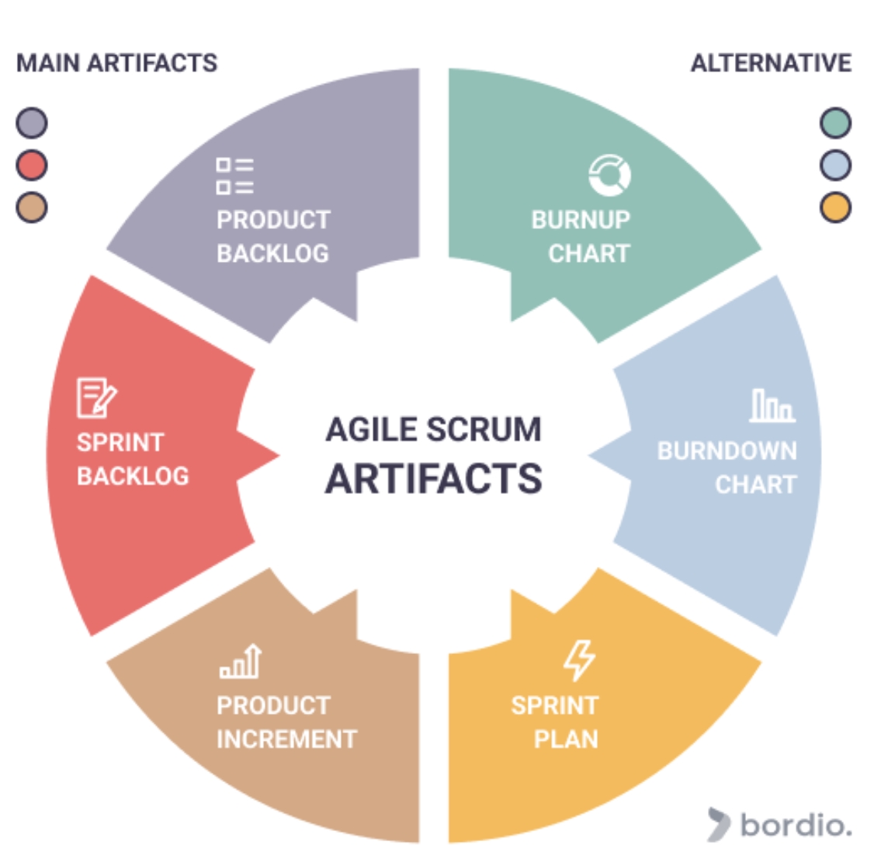
SCRUM ARTIFACTS
An ordered list of all requirements needed for the product, maintained by the Product Owner.
Tracks completed work over time, visually displaying remaining work against the total, indicating progress toward a release.
A subset of the product backlog selected for the Sprint, detailing the tasks needed to complete the selected backlog items.
A visual tool that shows remaining work versus time, highlighting total effort per iteration.
The total of completed backlog items across Sprints, yielding a shippable product after each Sprint.
An action plan developed in Sprint Planning that outlines tasks and execution methods for the Sprint.

Slide 12
SCRUM EVENTS (Ceremonies)
Sprint Review
Conducted at Sprint's end to review the Increment and update the Product Backlog.
Daily Scrum
Sprint Retrospective
A 15-minute daily meeting for the Development Team to synchronize tasks.
Reflect on the past Sprint to enhance processes and team interactions.
Sprint Planning
Story Time
Set objectives, select Product Backlog items, and define a Sprint goal.
Regular session to refine Product Backlog items and ensure clarity and understanding for upcoming Sprints.

Slide 13
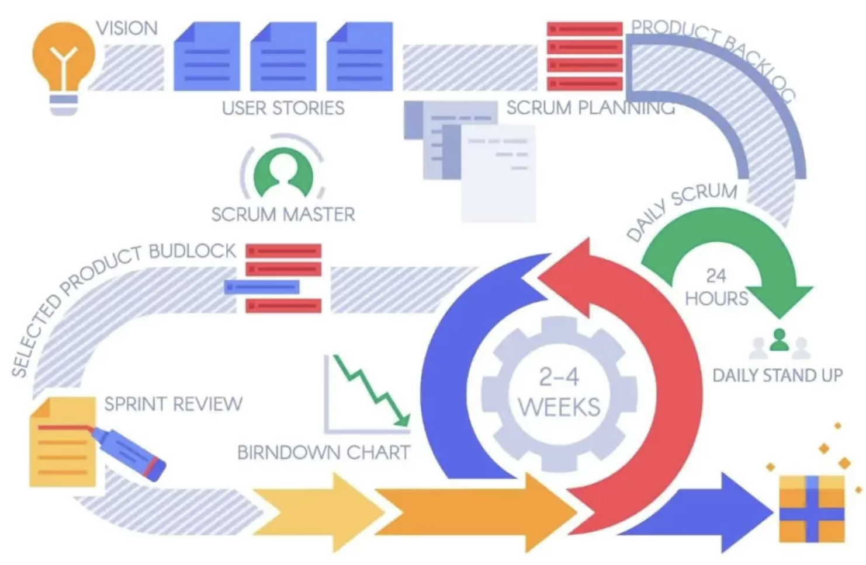
SCRUM PROCESS FLOW

Slide 14

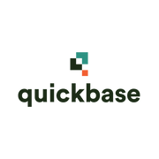
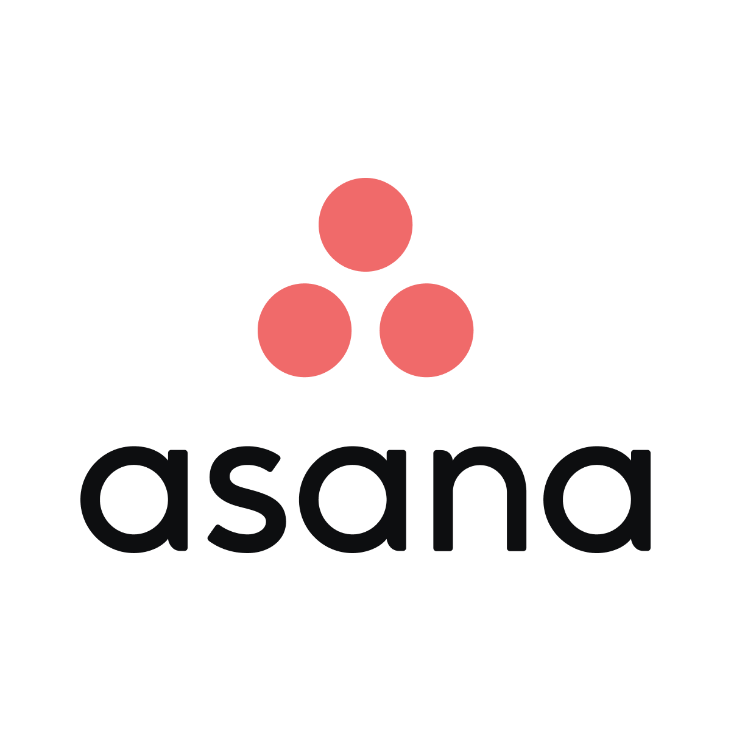
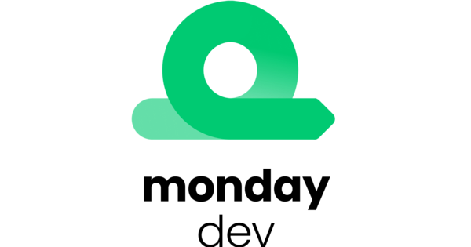
MOST POPULAR SCRUM TOOLS
JIRA SOFTWARE
QUICKBASE
ASANA
MONDAY DEV
GENERAL ELECTRIC
TESLA
UBER
AMAZON
ACCENTURE
MARIOTT
AIRBNB
SALESFORCE
CISCO
NCR CORPORATION
PINTEREST
AMWAY

Slide 15
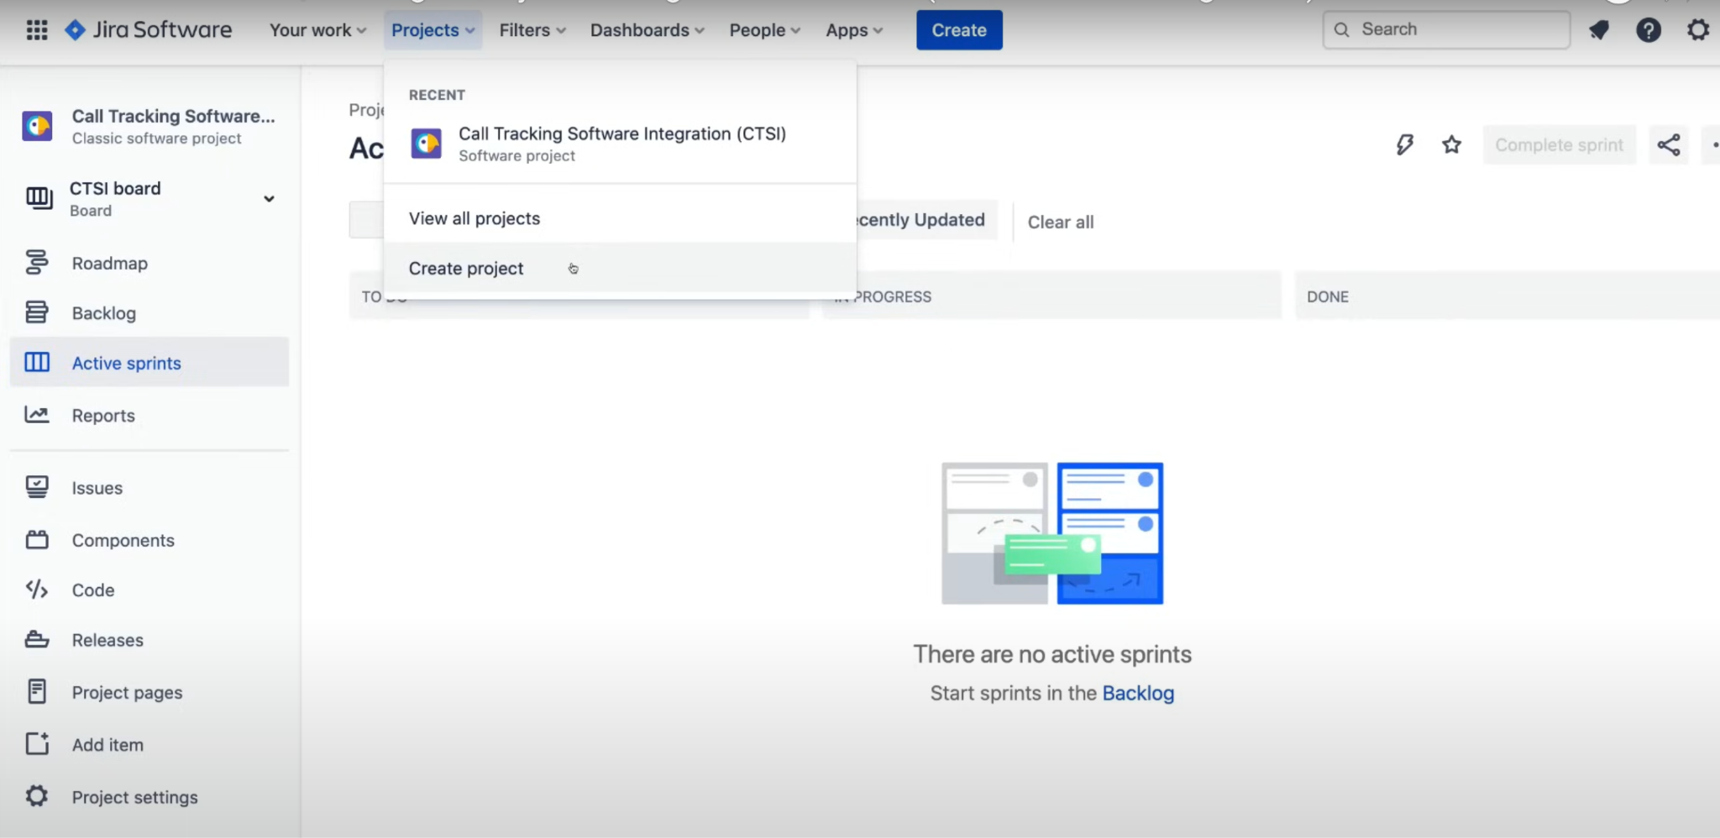
JIRA SOFTWARE
JIRA DASHBOARD

Slide 16
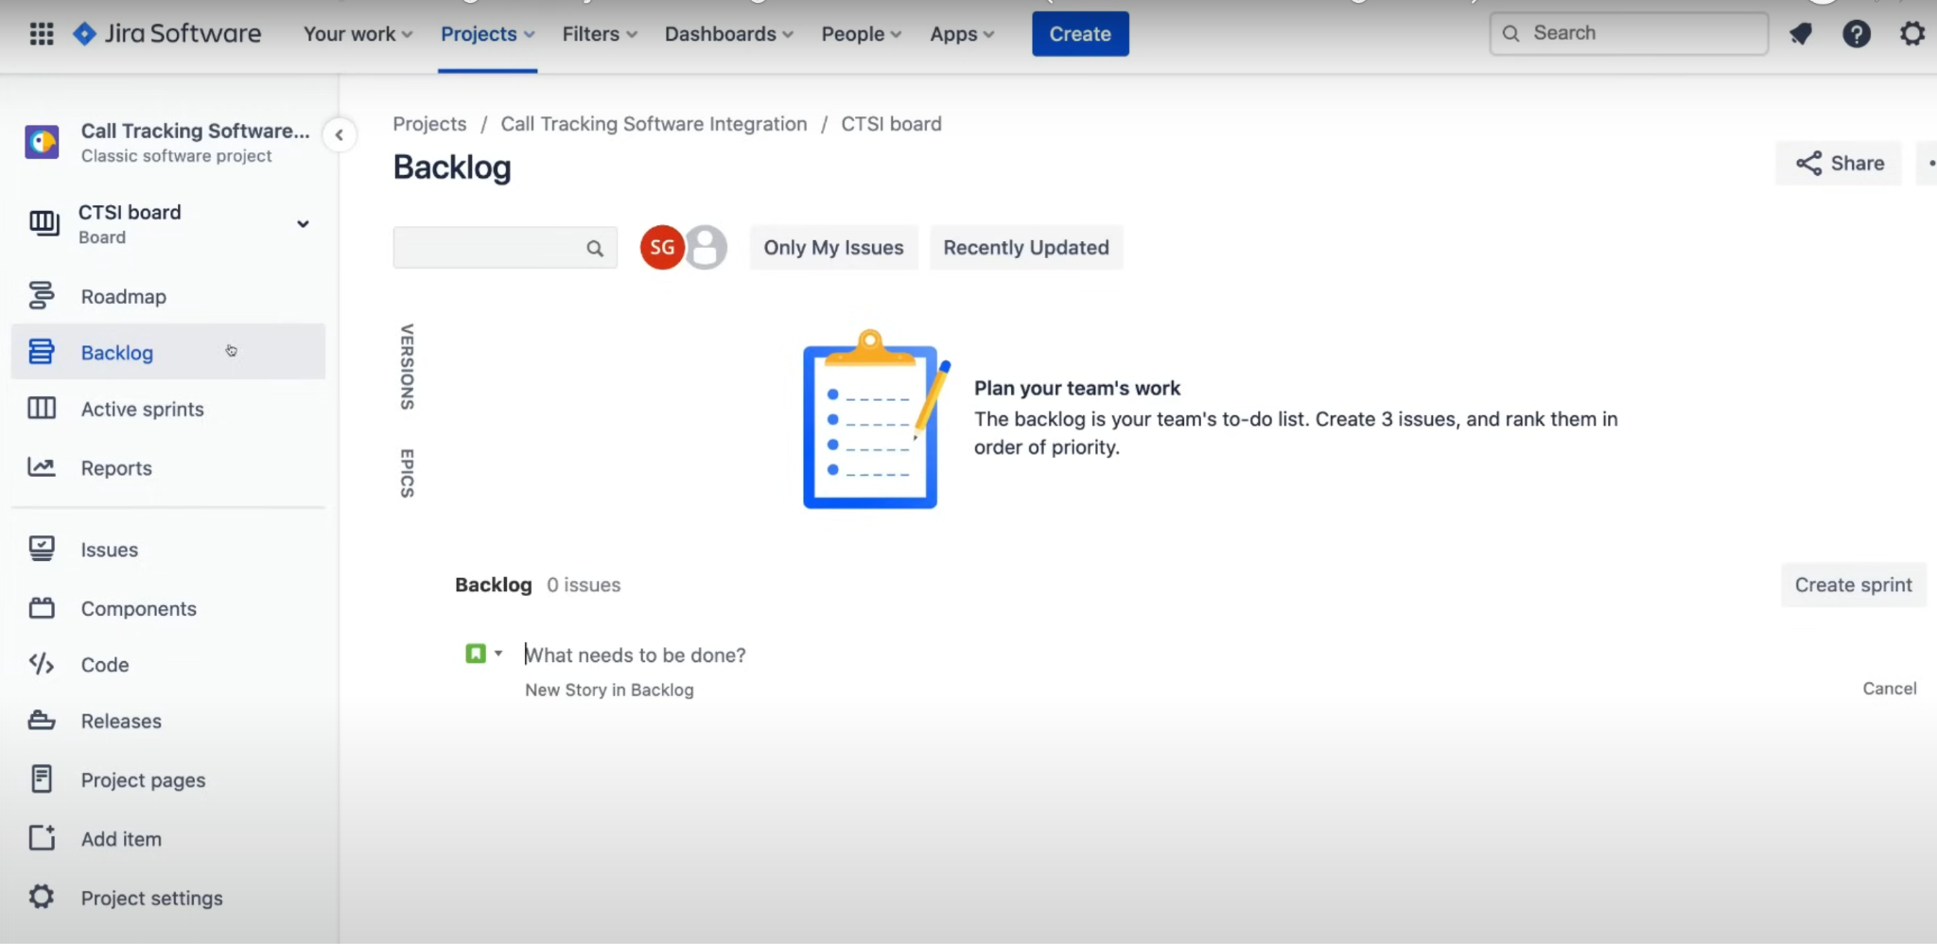
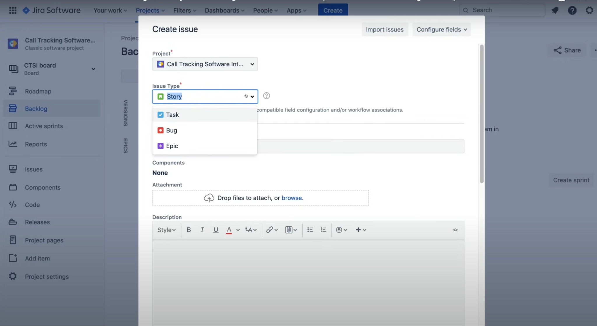
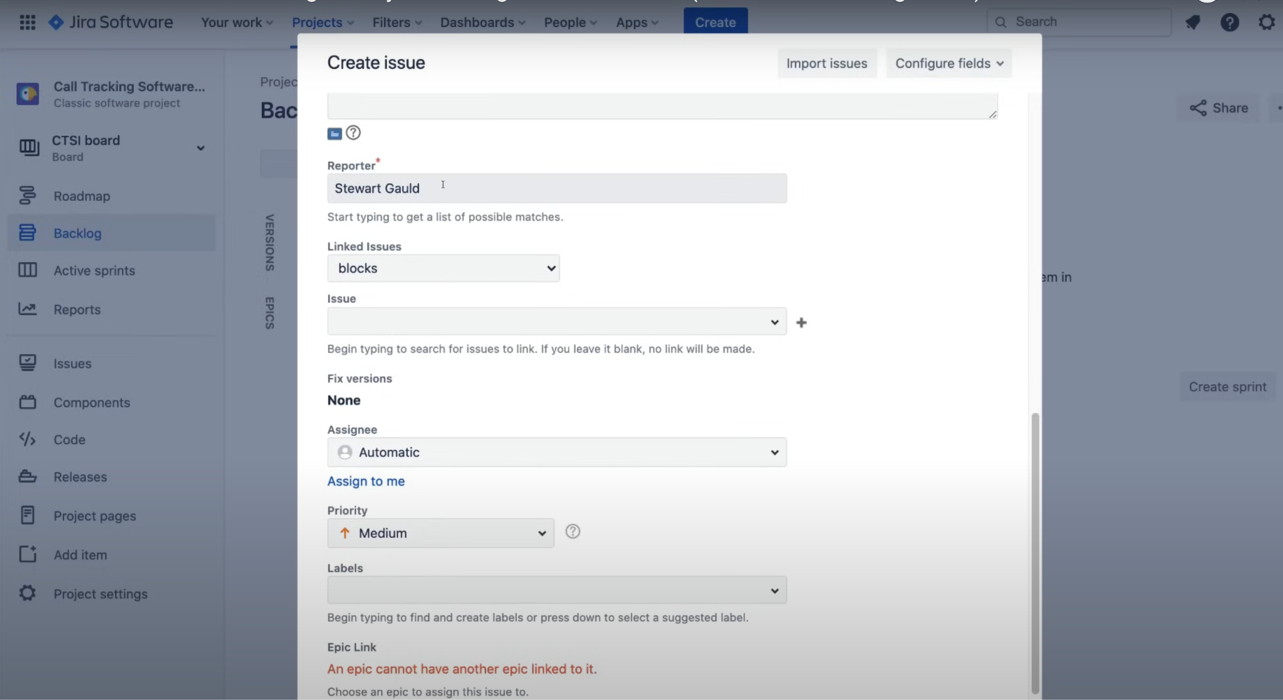
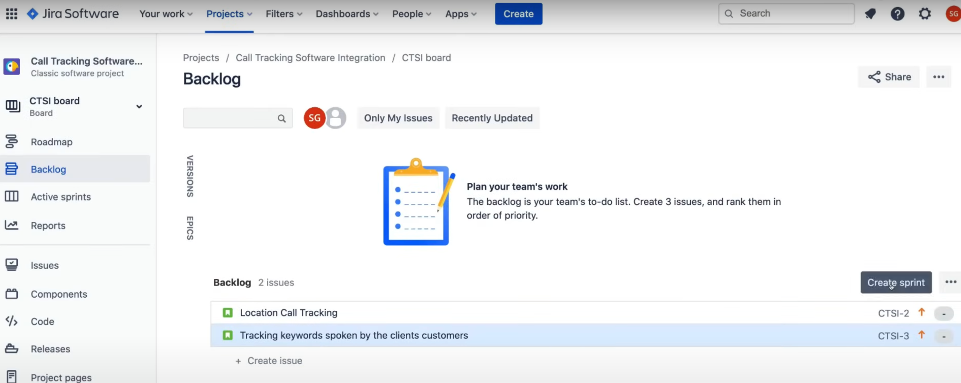
JIRA SOFTWARE
BACKLOG

Slide 17
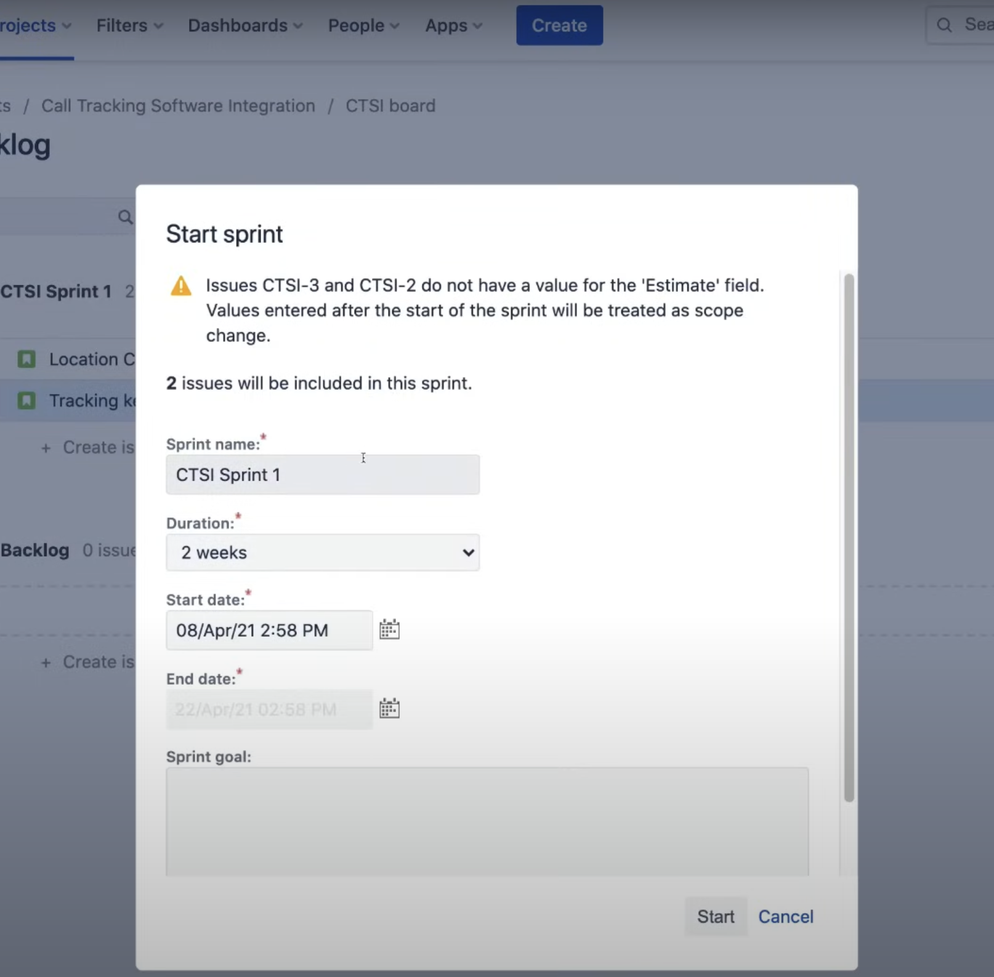
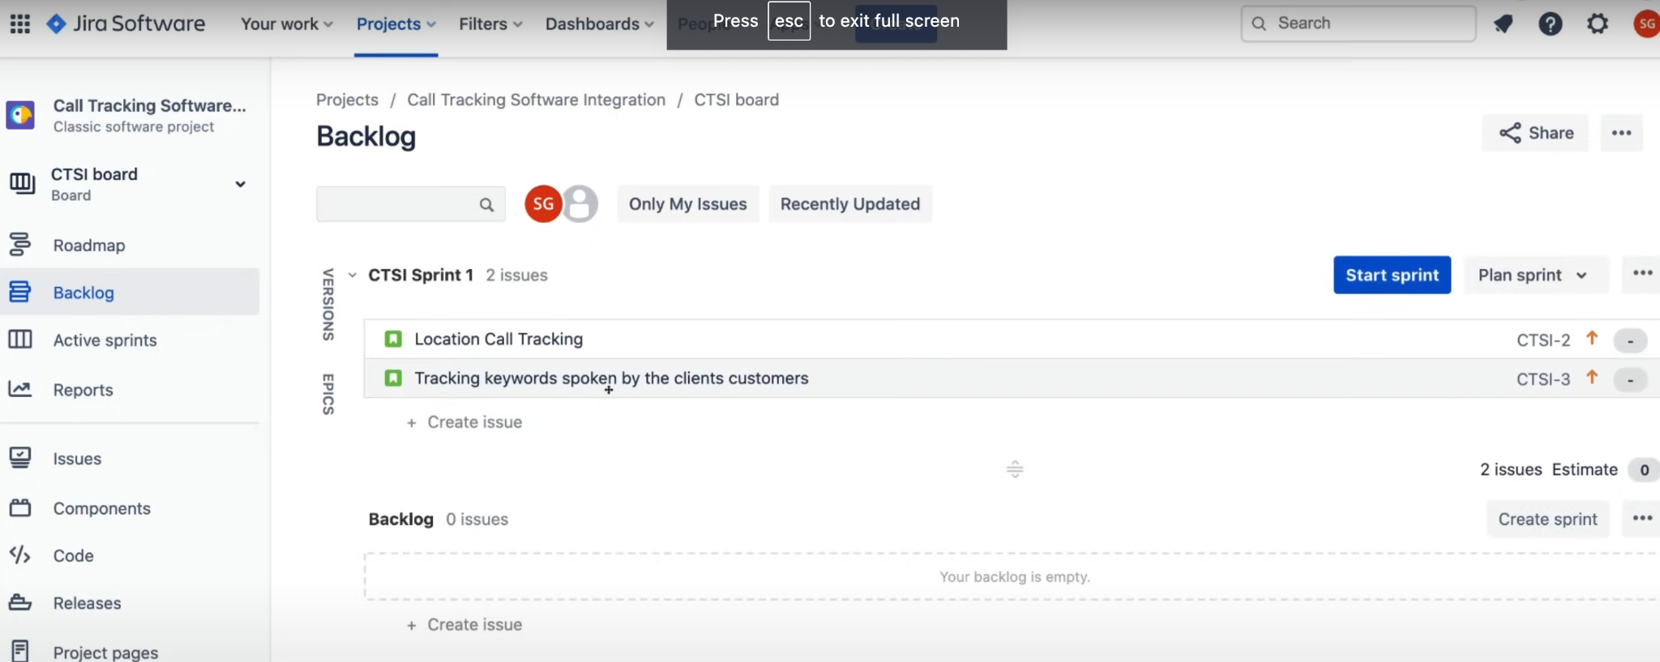
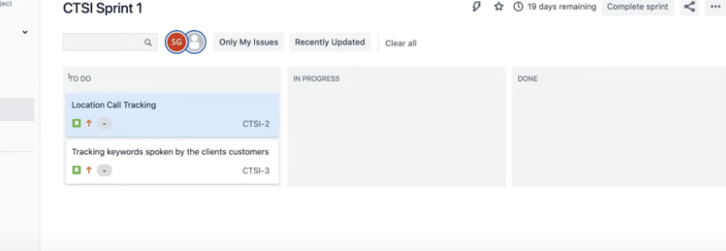
JIRA SOFTWARE
Sprint

Slide 18
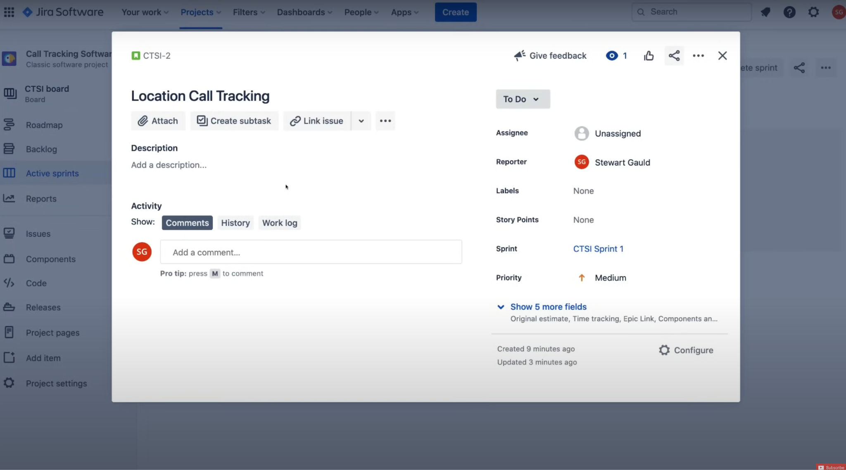
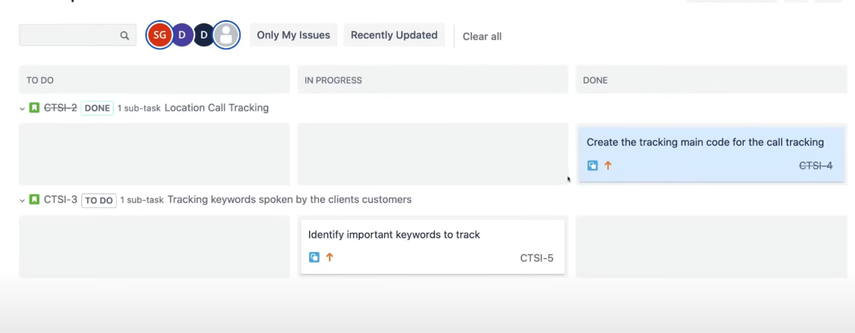
JIRA SOFTWARE
Sprint

Slide 19
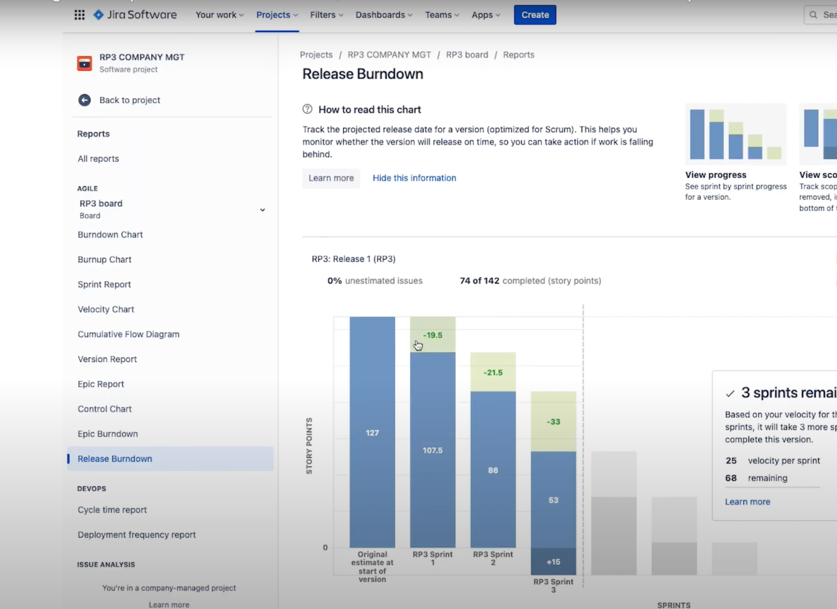
JIRA SOFTWARE
Reports (Burndown/ Burnup)

Slide 20
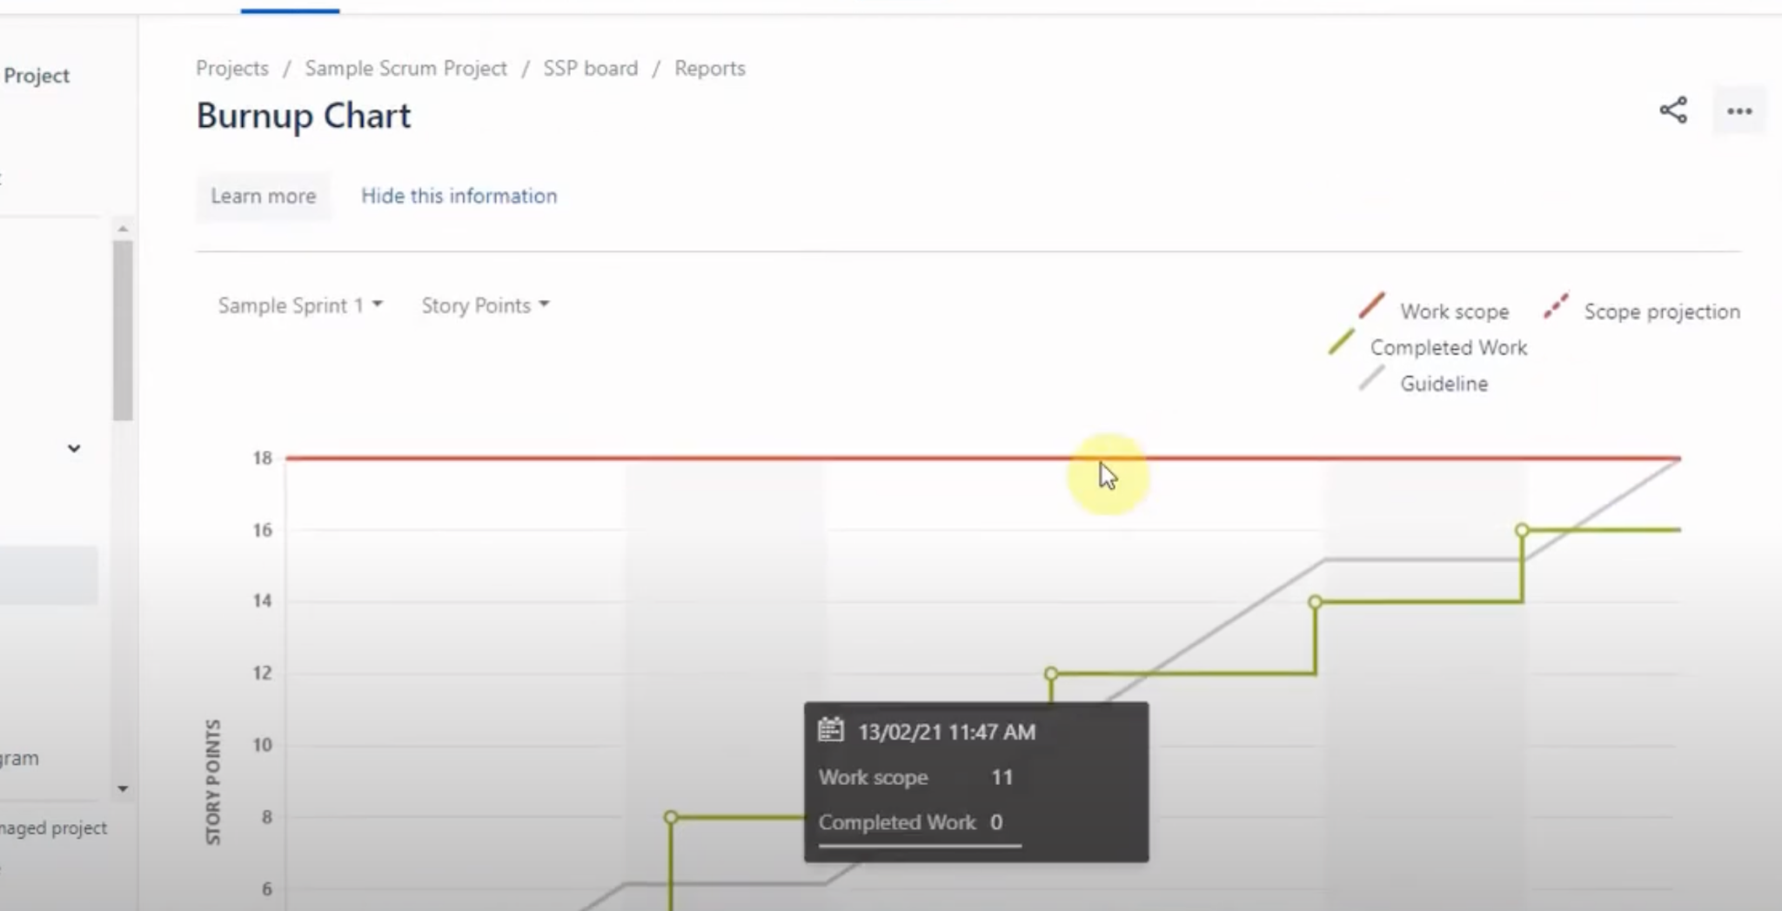
JIRA SOFTWARE
Reports (Burndown/ Burnup)

Slide 21
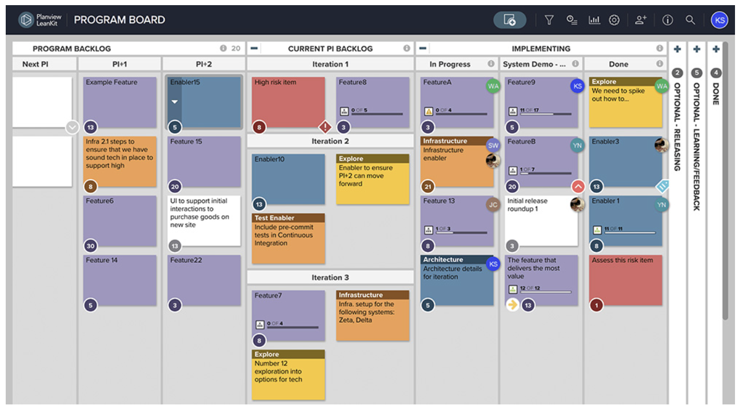




Key Agile Framework
KANBAN
Focus on workflow management
Continuous delivery without fixed iterations
Emphasizes visualizing work and limiting work in progress
Kanban Board
Cards
Columns
Work in progress Limits

Slide 22
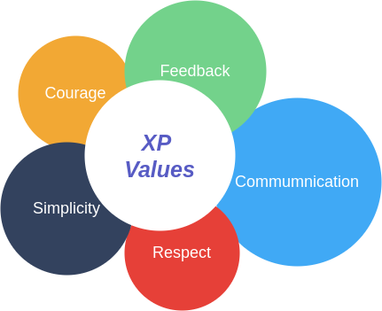
Key Agile Framework
Key Practices
XP (Extreme Programming)
Technical excellence and customer involvement
Practices include pair programming and test-driven development
Frequent releases for responsiveness
Pair Programming
Continuous Integration
Simple Design
Regularly merge and test code to identify and fix issues promptly.
Develop the simplest effective design for current requirements.
Two programmers collaborate at one workstation, sharing coding tasks.
Test Driven Development (TDD)
Refactoring
Consistently enhance the code base for better design and functionality without altering behavior.
Write tests before coding to validate functionality of each increment.

Slide 23
Key Agile Framework
Core Principals
Lean
Inspired by lean manufacturing principles
Focuses on eliminating waste
Maximizes value through efficiency
01
03
05
07
Eliminate Waste
02
Decide as late as possible
04
Empower the team
06
See the whole
Cut non-value- adding activities.
Let teams self-manage for better results
Delay decisions for better outcomes
Understand the project comprehensively to prevent sub- optimization
Amplify Learning
Deliver as fast as possible
Build Integrity
Foster continuous learning through feedback
Accelerate delivery for rapid feedback
Maintain a cohesive, well-tested system.

Slide 24
WHICH FRAMEWORK TO CHOOSE : Comparison analysis
Factor | Scrum (Weight) | Kanban (Weight) | XP (Weight) | Lean (Weight)
Project Complexity | 5 (High) | 3 (Medium) | 4 (Medium-High) | 2 (Low-Medium)
Urgency | 3 (Medium) | 5 (High) | 4 (Medium-High) | 4 (Medium-High)
Quality Focus | 4 (Medium-High) | 3 (Medium) | 5 (High) | 4 (Medium-High)
Team Size | 4 (Medium-High) | 5 (High) | 3 (Medium) | 5 (High)
Skill Levels | 4 (Medium-High) | 5 (High) | 2 (Low-Medium) | 5 (High)
Self-management | 4 (Medium-High) | 5 (High) | 3 (Medium) | 5 (High)

Slide 25
WHICH FRAMEWORK TO CHOOSE : Comparison analysis
Factor | Scrum (Weight) | Kanban (Weight) | XP (Weight) | Lean (Weight)
Culture | 4 (Medium-High) | 5 (High) | 4 (Medium-High) | 5 (High)
Stakeholder Involvement | 5 (High) | 4 (Medium-High) | 5 (High) | 4 (Medium-High)
Flexibility | 3 (Medium) | 5 (High) | 5 (High) | 5 (High)
Predictability | 5 (High) | 3 (Medium) | 4 (Medium-High) | 3 (Medium)
End Goals | 5 (High) | 4 (Medium-High) | 4 (Medium-High) | 5 (High)
Training & Resources | 4 (Medium-High) | 5 (High) | 3 (Medium) | 4 (Medium-High)

Slide 26
03
Agile Manifesto and 12 Principles

Slide 27
Let’s understand what Agile Manifesto is.
What is it?
The Agile Manifesto is a document that identifies four key values and 12 principles that its authors believe software developers should use to guide their work.
It was produced by 17 developers during an outing on Feb. 11-13, 2001, at The Lodge at Snowbird ski resort in Utah. The group named themselves “The Agile Alliance”
The history
The purpose
An increasing need for an alternative to documentation-driven and heavyweight software development processes.
The creators did not set out to develop a rigid framework or methodology. Instead, they created a philosophical mindset for software development.
It’s a mentality

Slide 28
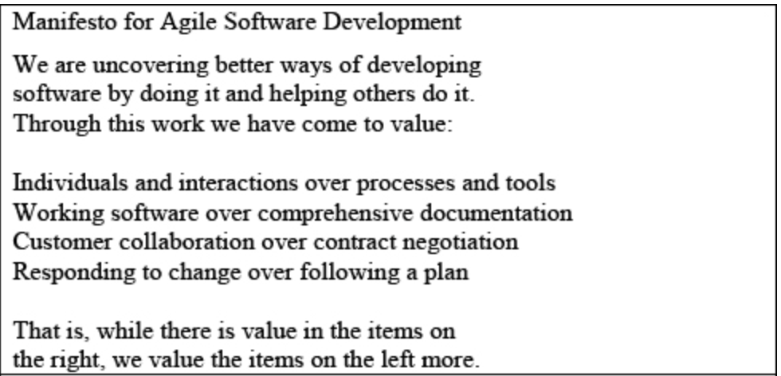
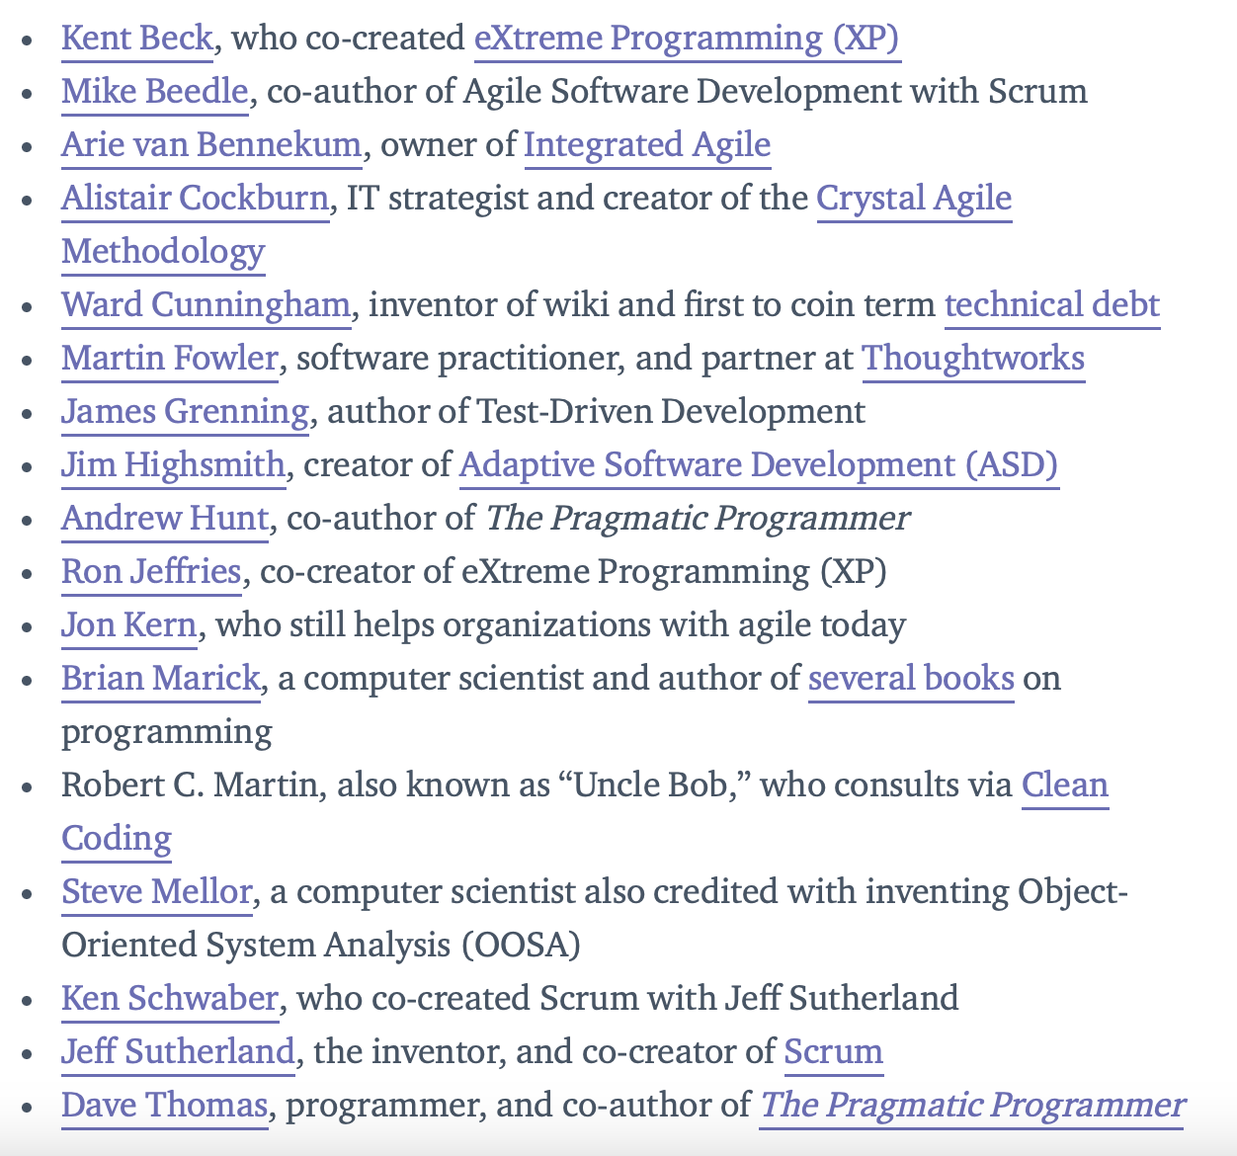
The Agile Alliance and Manifesto :
Kent Beck - Known for creating Extreme Programming, one of the first Agile methodologies.
Ken Schwaber - Co-creator of Scrum, another foundational Agile methodology.
Jeff Sutherland - Also a co-creator of Scrum, instrumental in its development and widespread adoption.
Ward Cunningham - Inventor of the wiki, contributing significantly to the way Agile teams communicate and collaborate

Slide 29
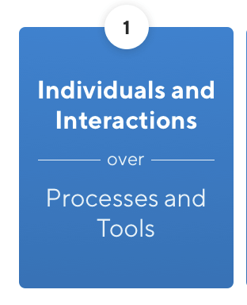
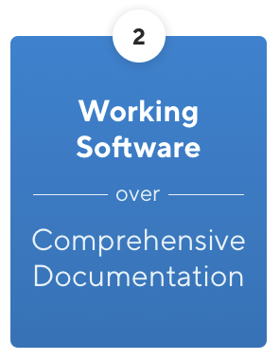
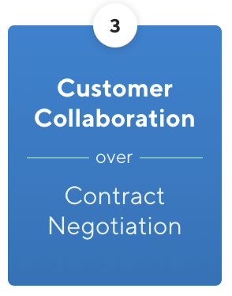
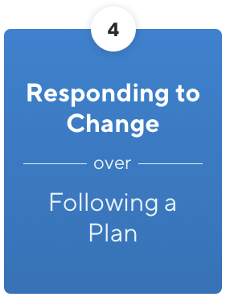
The FOUR Agile Values:
Agile emphasizes the importance of people and collaboration in software development.
It's more about getting results quickly than writing lots of paperwork.
By involving customers in every stage of the project, teams can ensure that the final product meets their requirements..
Teams should be flexible and adaptive, responding quickly to changing requirements and priorities to deliver.

Slide 30
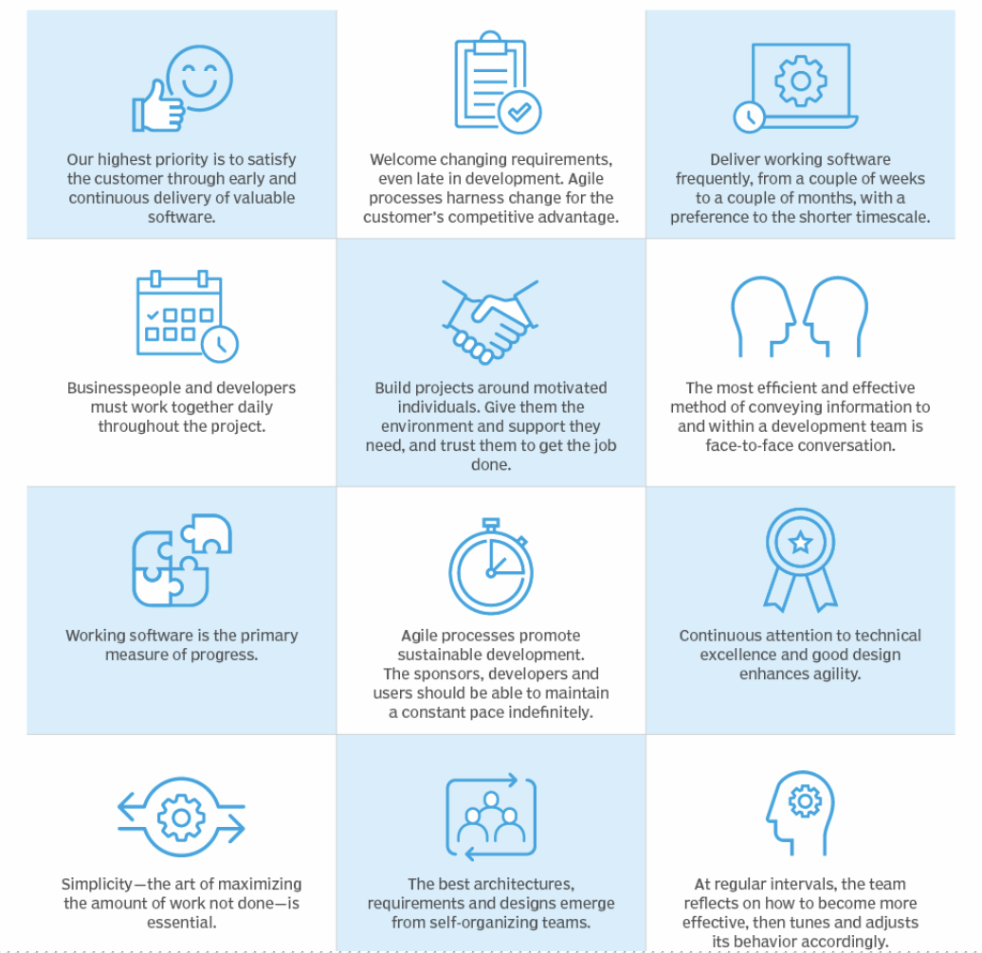
Now let’s talk about the 12 principles:

Slide 31
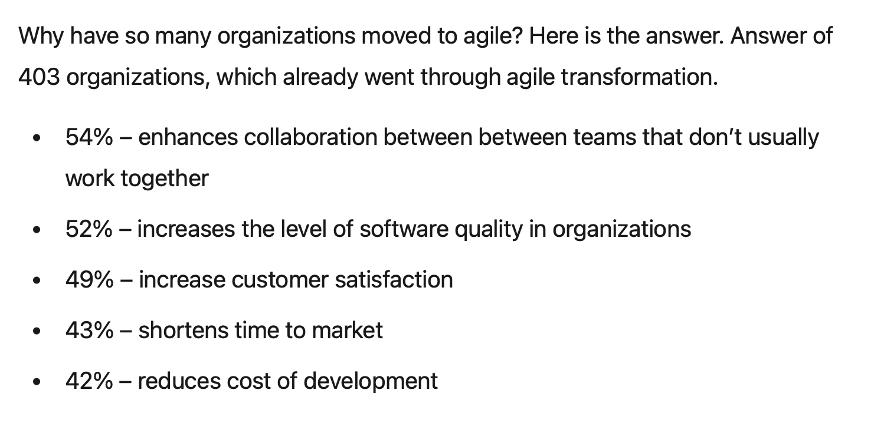
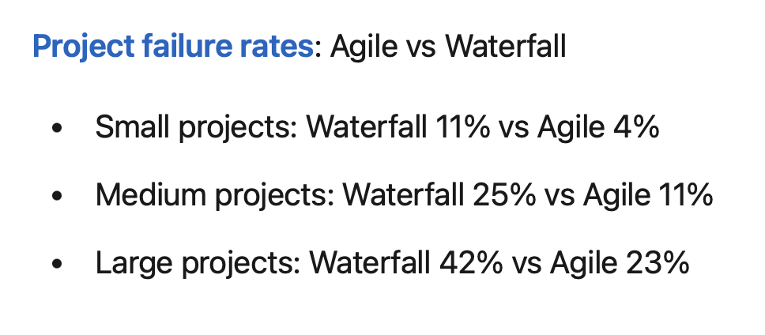
Some stats about the Adoption of Agile by various companies:

Slide 32
04
Implementation Strategies

Slide 33
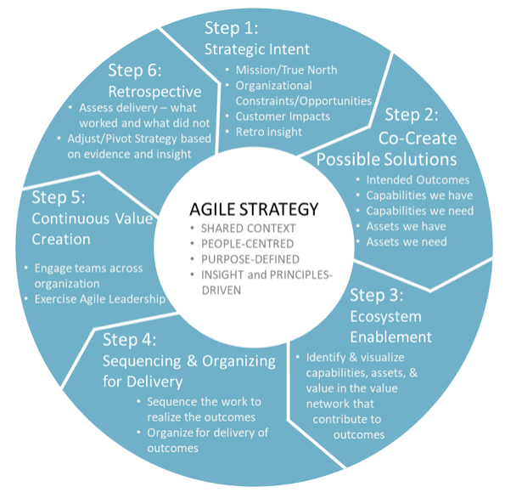
Implementing Agile Strategies:
Rather than rigidly planning and then executing, agile strategy is focused on identifying and testing possible solutions, then continually revising those solutions based on evidence and insights.
Agile strategy relies on a “strategic discovery” process. Recognizing this as a discovery process versus a planning process frees leaders and teams to be open to new evidence and insights that will influence strategy in a continuing feedback loop. The strategic discovery process should take 90 days. It should then be repeated, with revisions, in each subsequent 90-day period.

Slide 34
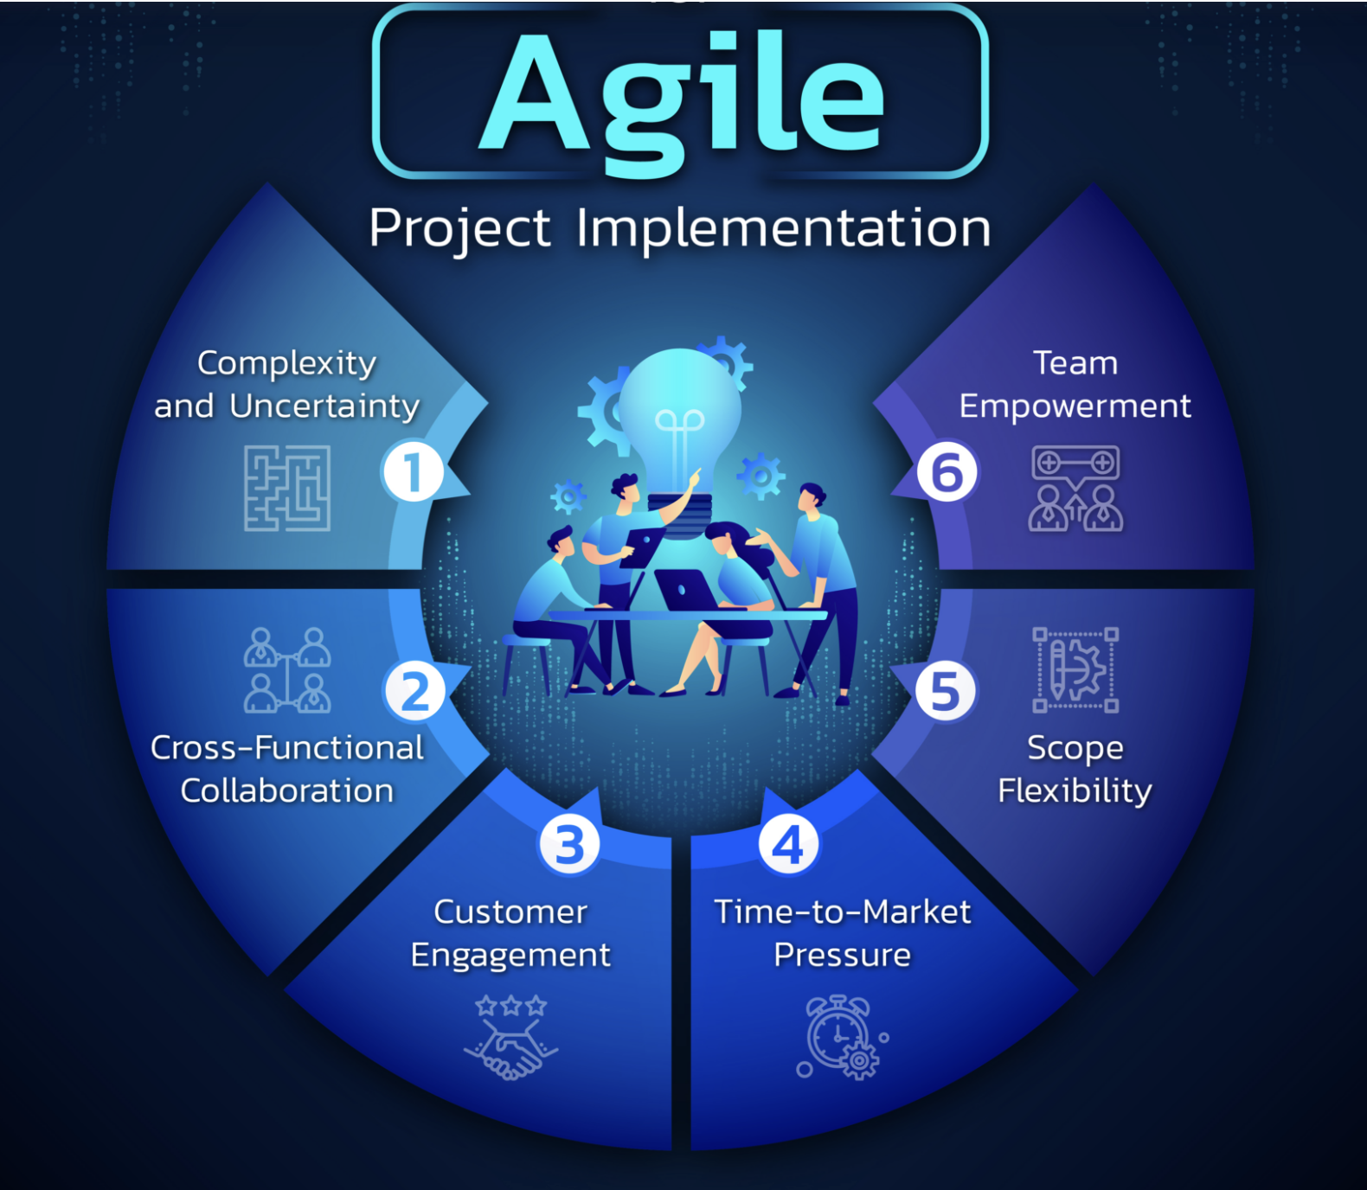
Key considerations while implementing agile strategies:
Complexity & Uncertainty
Agile is ideal for projects with unclear requirements, changing markets, or new technologies. It uses iterations and feedback to help teams adapt and ensure the final product meets customer needs.
Cross-Functional Collaboration
Agile methodologies emphasize collaboration and self-organizing teams. Projects that require cross-functional collaboration, where different expertise and skills are essential for success, are well-suited for agile.

Slide 35
Key considerations while implementing agile strategies:
Customer Engagement:
Agile emphasizes customer collaboration throughout the project life cycle. Hence, projects that involve a high level of customer interaction, such as software development or product design, are excellent fits for agile.
Time- to- Market Pressure:
An agile approach is beneficial for projects with time-sensitive goals, where delivering key features or prototypes early is crucial. By dividing the project into smaller increments, teams can deliver tangible results to stakeholders promptly, while retaining flexibility for future iterations.

Slide 36
Key considerations while implementing agile strategies:
Team Empowerment:
Agile teams excel in autonomous environments that foster creativity and value expertise. By promoting trust and empowerment, agile teams leverage collective knowledge to achieve outstanding outcomes.
Scope Flexibility:
Agile methodologies, ideal for projects with evolving requirements, prioritize customer value through incremental delivery and continuous feedback. Effective implementation involves investing in tooling, addressing change management, and defining clear KPIs to ensure project success.

Slide 37
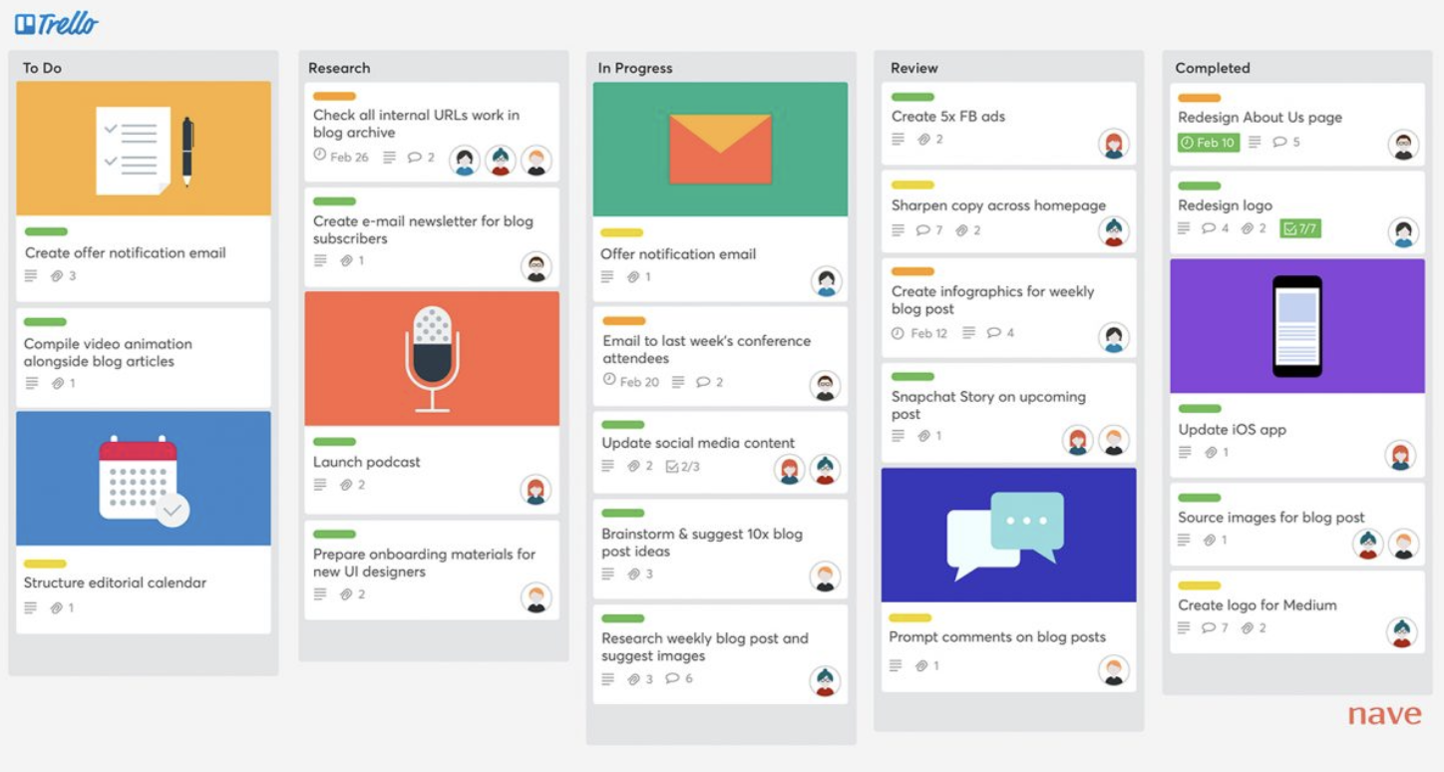
PM tools for Agile: KANBAN BOARDS
Splitting Projects into User Stories:
Break down projects into user stories to deliver customer value quickly.
Define process states like "To Do," "Doing," and "Done" to track progress.
Applying Work In Progress Limits:
Set WIP limits for each "Doing" state to prevent task overload.
Maintaining WIP limits enhances team focus, reduces cycle times, and boosts customer satisfaction.
Prioritizing Tasks:
Prioritize tasks from top to bottom based on their importance.
When a "Doing" slot becomes available, move the highest-priority "To Do" task to maintain flow and increase team productivity.

Slide 38
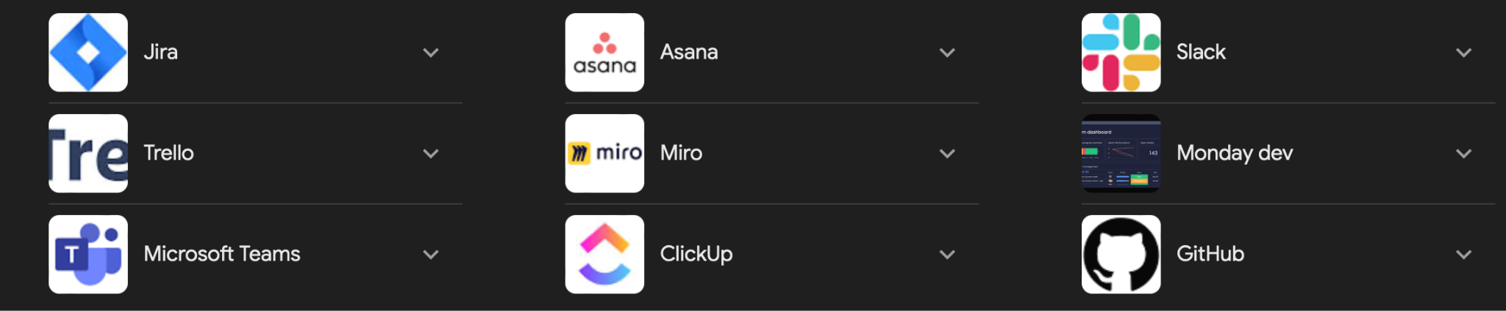
PM tools for Agile: COLLABORATION PLATFORMS
Collaboration tools are crucial to enable teams to work together. These include: Collaborative dashboards to track work and provide details of sub-tasks as part of the bigger project picture
Communication tools that connect team members, including office-based and deskless workers wherever they are in the world. This is even more important with hybrid working and also means teams can work internationally with fewer barriers
File sharing tools to give every team member access to the documents they need. Integration tools to bring all software and applications together, so there’s no wasting time when continually moving between them
Progress monitoring tools help project managers plan more effectively and keep teams on schedule by tracking progress in real time

Slide 39
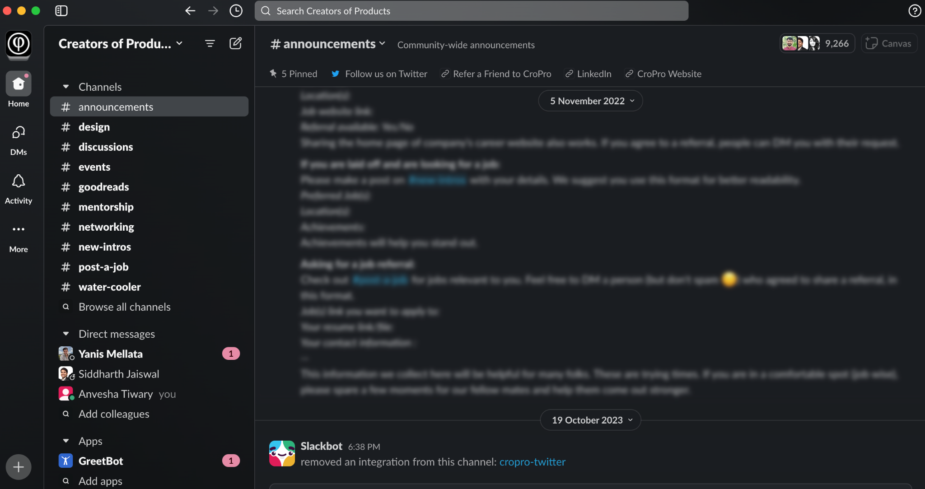
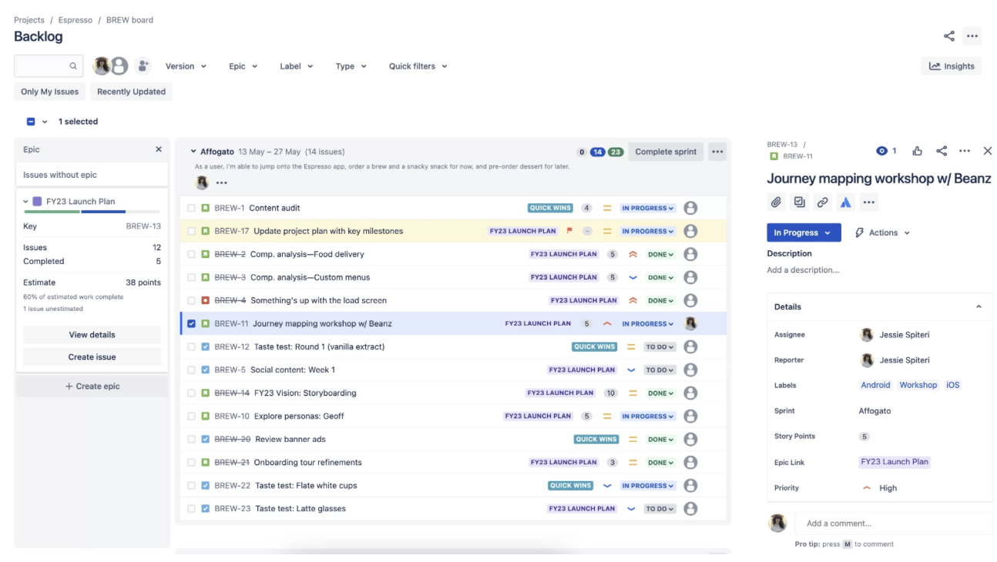
PM tools for Agile: COLLABORATION PLATFORMS

Slide 40
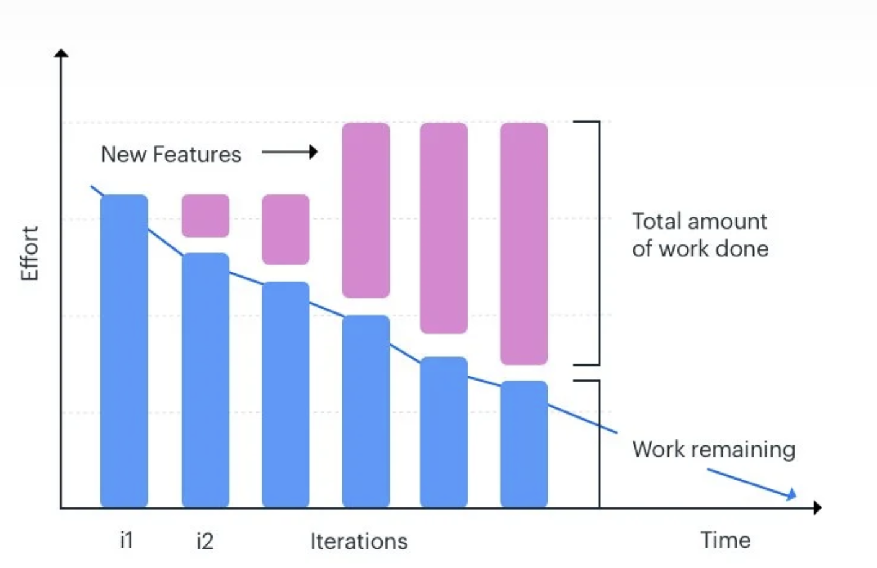
PM tools for Agile: BURNDOWN CHARTS
Burndown charts graphically illustrate how fast your team is working by plotting user stories against time. It works from the end user’s perspective, so the chart is only updated after the successful completion of a user story. The burndown chart is also used to record a team’s pace, called velocity, and predict their performance. In agile projects, burndown charts are generally of two types – product burndown charts and sprint burndown charts. Product burndown charts focus on the big picture and visualize the entire project. The chart tells you how many of the product goals your team has achieved so far and how much work is left.

Slide 41
Advantages of Implementing Agile
Advantages
Satisfied customers: Agile's customer involvement fosters engagement and feedback throughout the project, ensuring tailored solutions that enhance user experience and increase customer retention.
Flexibility:
Agile prioritizes adaptability and responsiveness, enabling frequent adjustments based on evolving requirements, leading to products better suited to stakeholder needs and market demands.
Improved Quality:
Agile's iterative approach focuses on continual improvement, enhancing product quality over time.
Better Communication:
Agile teams prioritize face-to-face communication and daily meetings to ensure alignment and eliminate confusion, fostering effective collaboration towards shared objectives.
Reduced Risk:
Regular progress assessments during sprints allow for early detection and mitigation of potential obstacles, minimizing project risks and increasing chances of success.
Predictability:
Fixed-duration sprints enable better measurement of team performance and cost estimation, enhancing predictability in project delivery.

Slide 42
Challenges of Implementing Agile
Challenges
Scaling Agile for large teams:
Scaling Agile adoption in enterprises reveals a gap between business leaders' focus on customer value and Agile's original intent, potentially causing culture clashes and alignment challenges.
Resistance to Change: Integrating Agile into rigid frameworks poses challenges due to differing operational styles, requiring effective change management and careful consideration for optimal implementation.
Implementation across a hybrid workforce:
Implementing Agile in a hybrid workforce resembles scheduling a game with diverse players, requiring clear planning for successful collaboration despite varied participation modes.
Quality Control:
Implementing rigorous testing, automation, and code reviews ensures Agile deliverable quality. Balancing speed and quality is vital for customer value and product excellence.
Not everyone knows Agile:
According to the 17th State of Agile Report, “37% [of respondents] said business teams simply don’t understand what Agile is or what it can do, while 27% said there is not enough training.”
Maintaining up-to-date documentation:
Documentation maintenance is important in Agile for cohesive collaboration, ensuring streamlined processes and avoiding chaos.

Slide 43
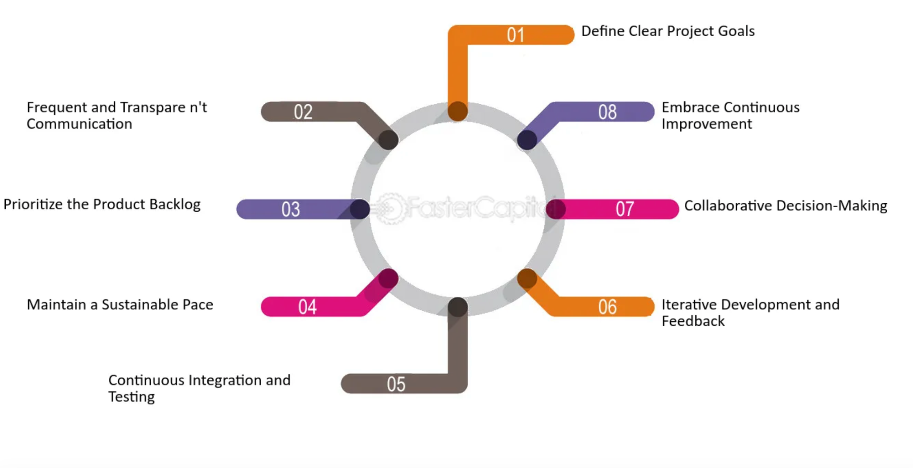
Emerging Practices/Recommendations for Implementing Agile:
Define Clear Project Goals:
Emerging Practice: Use OKRs (Objectives and Key Results) to set and communicate clear, measurable goals that align team efforts with the organizational vision.
Recommendation: Regularly review and adjust goals to stay responsive to changing market conditions and internal dynamics.

Slide 44
Emerging Practices/Recommendations for Implementing Agile:
Frequent and Transparent Communication:
Emerging Practice: Leverage collaboration tools that integrate seamlessly with your agile project management software to enhance communication across distributed teams.
Recommendation: Establish a routine for daily stand-ups and regular retrospectives to ensure ongoing dialogue and problem-solving.

Slide 45
Emerging Practices/Recommendations for Implementing Agile:
Prioritize the Product Backlog:
Emerging Practice: Utilize AI-driven analytics to help prioritize the product backlog based on market trends, customer feedback, and predictive outcomes.
Recommendation:
Engage stakeholders in regular sessions to refine the project backlog, ensuring that priorities align with business value and technical feasibility.

Slide 46
Emerging Practices/Recommendations for Implementing Agile:
Continuous Integration/Development and Testing:
Emerging Practice: Adopt cloud-based CI/CD pipelines to allow for faster and more reliable code integration and testing phases.
Recommendation: Implement automated testing frameworks and practice TDD (Test Driven Development) to reduce bugs and improve software quality.

Slide 47
Emerging Practices/Recommendations for Implementing Agile:
Iterative Development and Feedback:
Emerging Practice: Integrate customer feedback loops with development sprints to adapt products quickly to user needs and expectations.
Recommendation: Use sprint demos to gather real-time feedback from stakeholders and refine future development cycles.

Slide 48
Emerging Practices/Recommendations for Implementing Agile:
Collaborative Decision-Making:
Emerging Practice:
Utilize decision-making frameworks to clarify roles and responsibilities in decisions.
Recommendation: Foster an environment where every team member feels empowered to contribute to decision-making processes.

Slide 49
Emerging Practices/Recommendations for Implementing Agile:
Embrace Continuous Improvement:
Emerging Practice: Leverage big data and analytics to continuously evaluate and improve processes, methodologies, and outcomes.
Recommendation: Regularly schedule innovation sprints to explore new ideas and technologies that could enhance productivity and results.

Slide 50
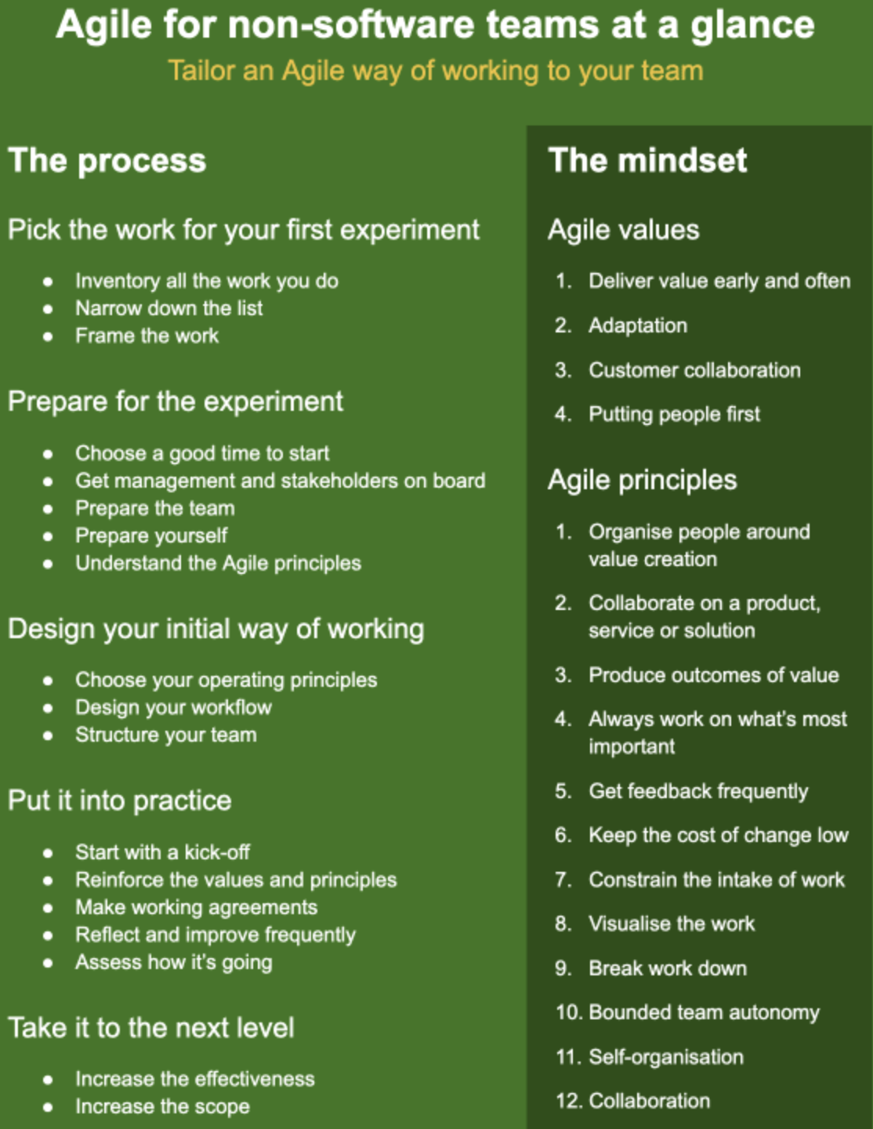
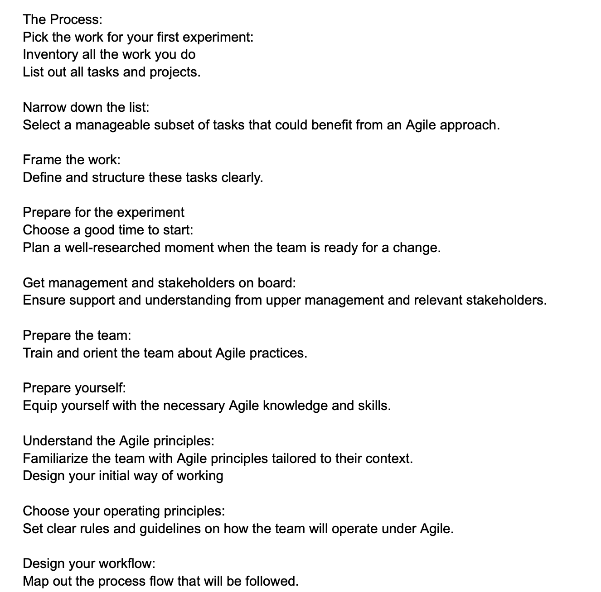
Agile for non-software departments:

Slide 51
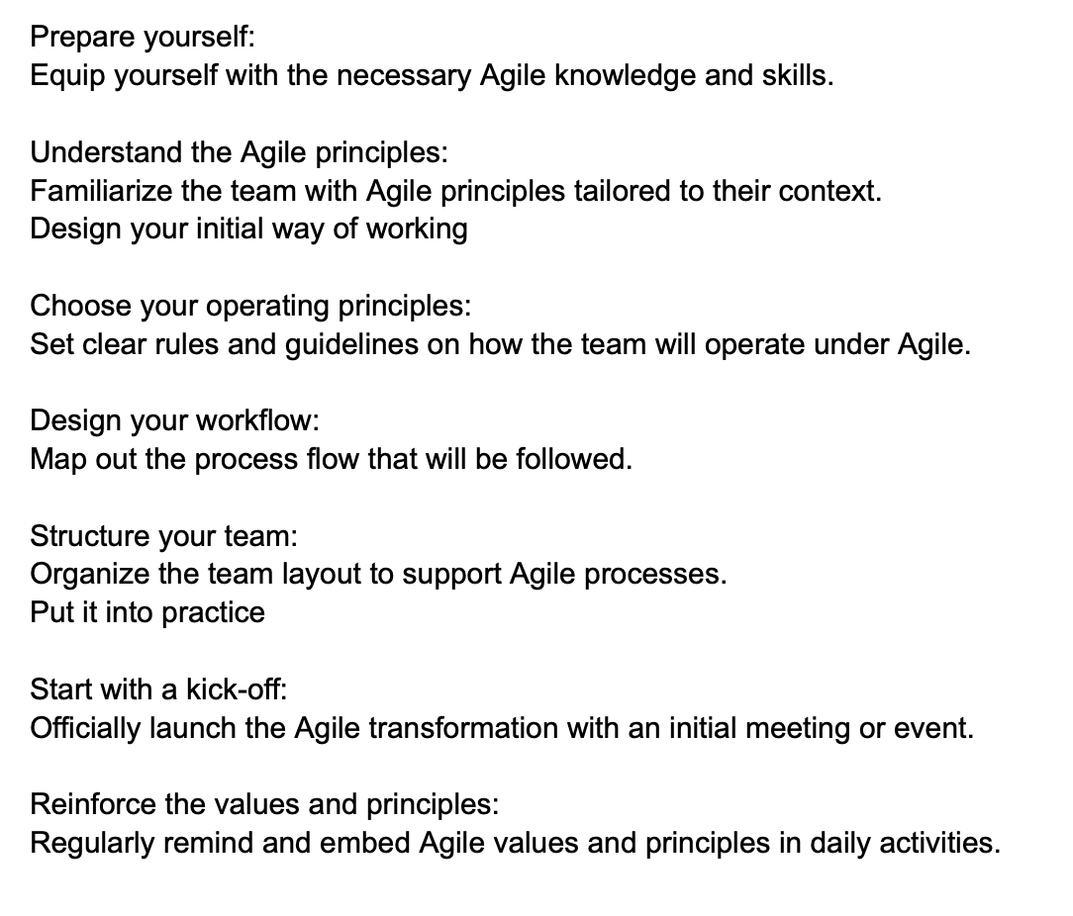
Agile for non-software departments:

Slide 52
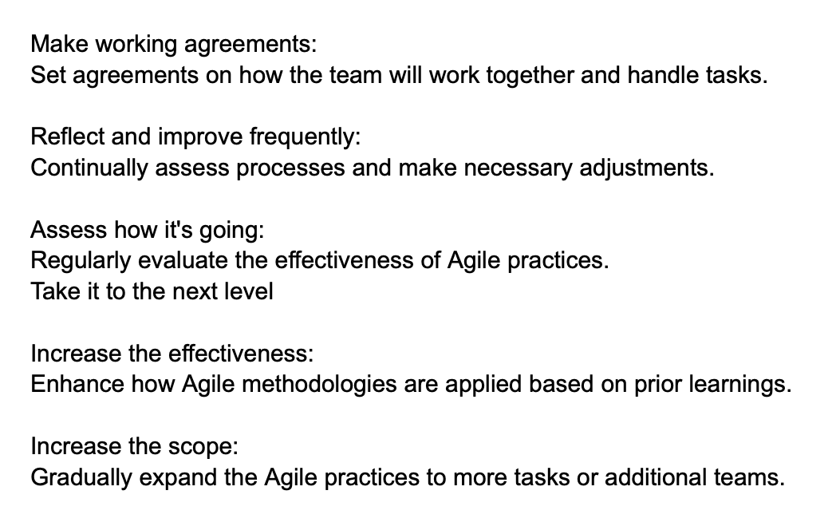
Agile for non-software departments:

Slide 53

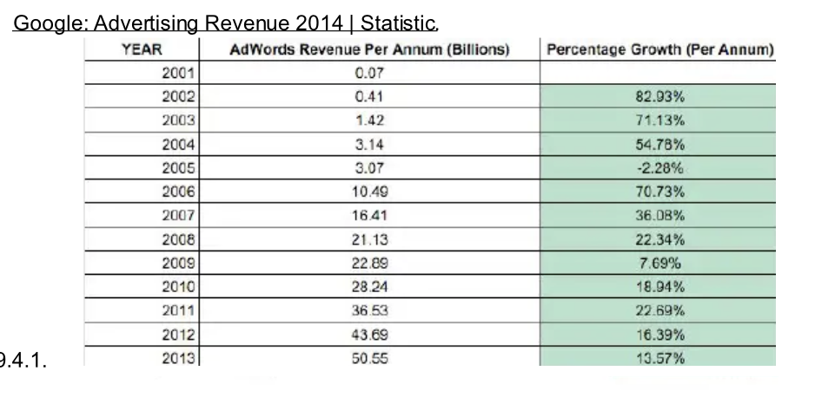
Case Study: Google AdWords
Scrum Introduction: Agile expert Mark Striebeck was hired to implement Scrum, addressing inefficiencies from AdWords' growing complexity.
Strategic Alignment: Scrum realigned project management with Google's strategic objectives for better business alignment.
Experimentation and Adaptation: Scrum was implemented on trial and adapted in specific AdWords applications to refine processes.
Enhanced Efficiency: Scrum improved operational efficiency and execution speed through structured sprints.

Slide 54
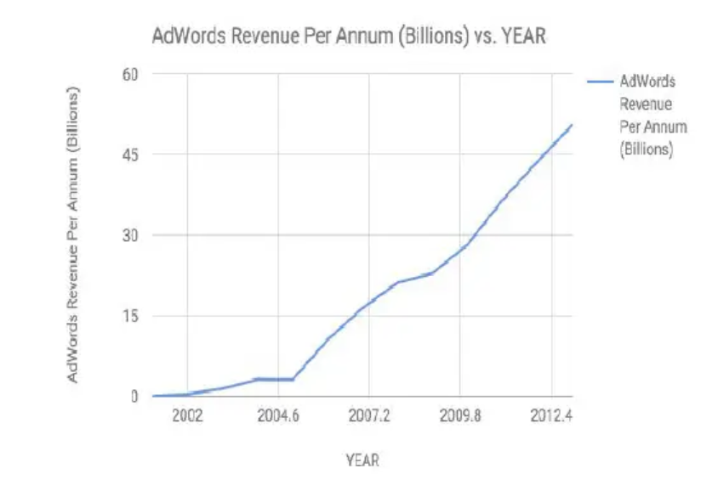
Case Study: Google AdWords
Cultural Retention:
The implementation supported Google's startup-like culture within a complex business unit.
Productivity and Workflow Management:
Scrum improved productivity and dynamic workflow management through focused sprints and regular reassessments.
Outcome Improvements:
Agile practices led to more effective feature delivery and improved stakeholder satisfaction.
(Google began implementing Agile methodologies, specifically Scrum, for AdWords in 2005)

Slide 55
05
Measuring and Scaling Agile
Notes:
Sej

Slide 56
Why an organization should Scale Agile ?
01
03
05
Increased business agility and responsiveness
02
Better visibility and transparency
Continuous learning and improvement
04
Consistent practices and reduced complexity
Improved alignment and coordination
Efficient resource allocation and utilization
Notes:
"Why Scale Agile" addresses the question of why an organization should scale Agile and the potential advantages they can gain

Slide 57
Key Components of scaling Agile:
01
03
05
07
Framework
Rituals
02
04
Iteration
06
Adaptation
08
Organizational structure and alignment
Ceremonies and events
Continuous Integration and Delivery
Transformation and Change Management
Artifacts
Evaluation
Oversight
Account-
ability
Roles and Responsibilities
Metrics and Measurements
Governance and Risk Management
Artifacts and work management
Notes:
"Key Components of Scaling Agile" outlines the specific components or mechanisms that an organization needs to put in place to successfully scale Agile

Slide 58
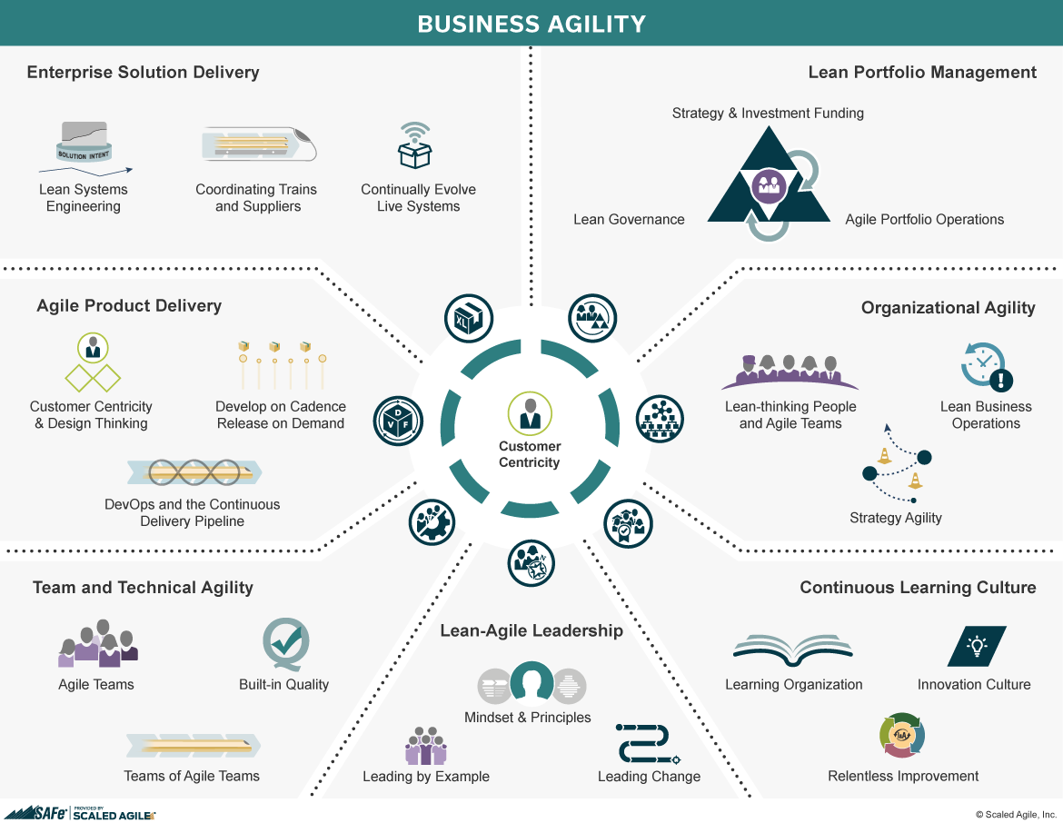
Frameworks to Scale Agile : SAFe , LeSS, Nexus
1. Scaled Agile Framework (SAFe)
SAFe is a popular and comprehensive framework for scaling Agile across an entire organization.
It organizes teams into Agile Release Trains (ARTs), which align with the organization's value streams.
SAFe emphasizes alignment, collaboration, and delivery of value through Program Increments (PIs) and synchronization events like PI Planning.
It provides roles, artifacts, and ceremonies to facilitate scaling Agile effectively.
Notes:
Sej

Slide 59
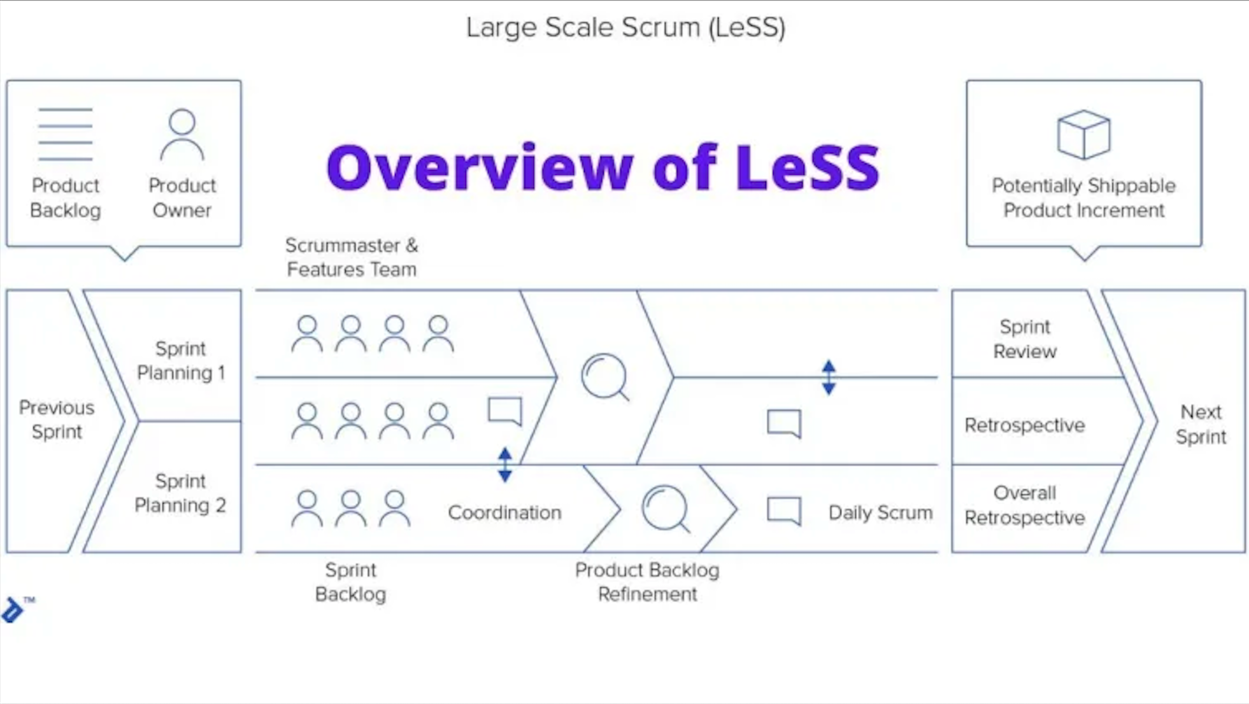
Frameworks to Scale Agile : SAFe , LeSS, Nexus
2. Large-Scale Scrum (LeSS)
LeSS is a lightweight framework for scaling Scrum to multiple teams working on the same product.
It emphasizes simplicity, transparency, and whole product focus.
LeSS promotes cross-team coordination through ceremonies like Overall Retrospective and Sprint Planning.
It introduces the concept of Feature Teams, which are cross-functional teams focused on end-to-end customer-centric features.
Notes:
Sej

Slide 60
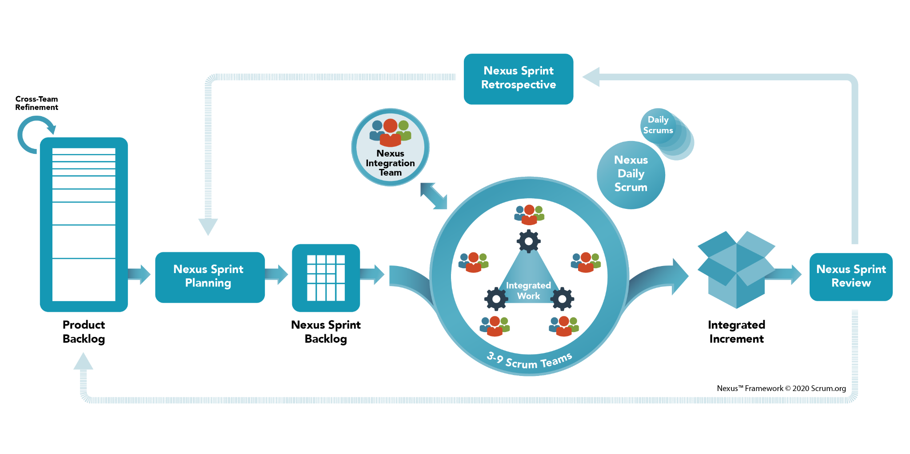
Frameworks to Scale Agile : SAFe , LeSS, Nexus
3. Nexus
Nexus is a scaling framework specifically designed for Scrum Teams.
It introduces the Nexus Integration Team, which integrates and coordinates the work of multiple Scrum Teams.
Nexus emphasizes continuous integration, refinement, and the Nexus Sprint Backlog as a single prioritized list of work.
It promotes transparency and alignment across teams through events like the Nexus Daily Scrum and Nexus Sprint Review.
Notes:
Sej

Slide 61
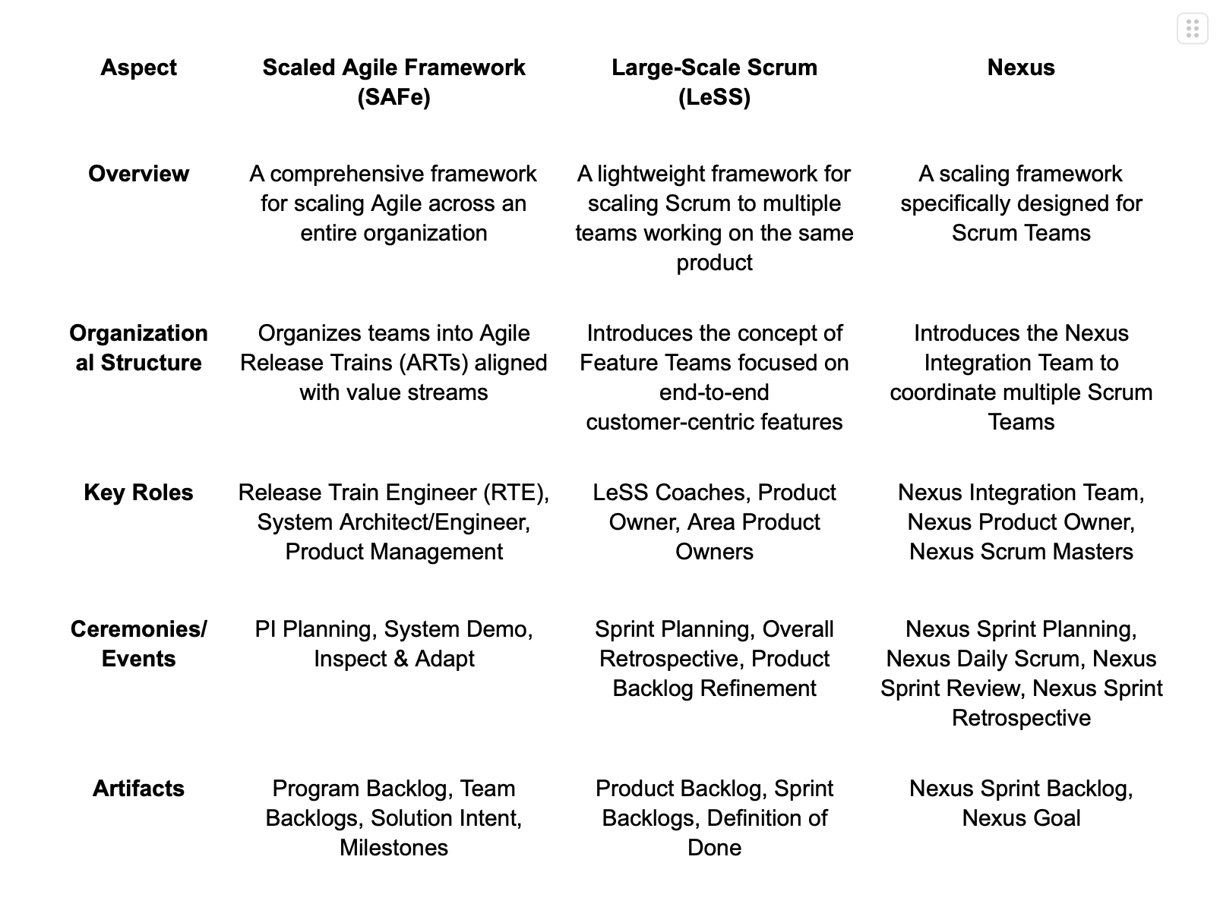

Slide 62
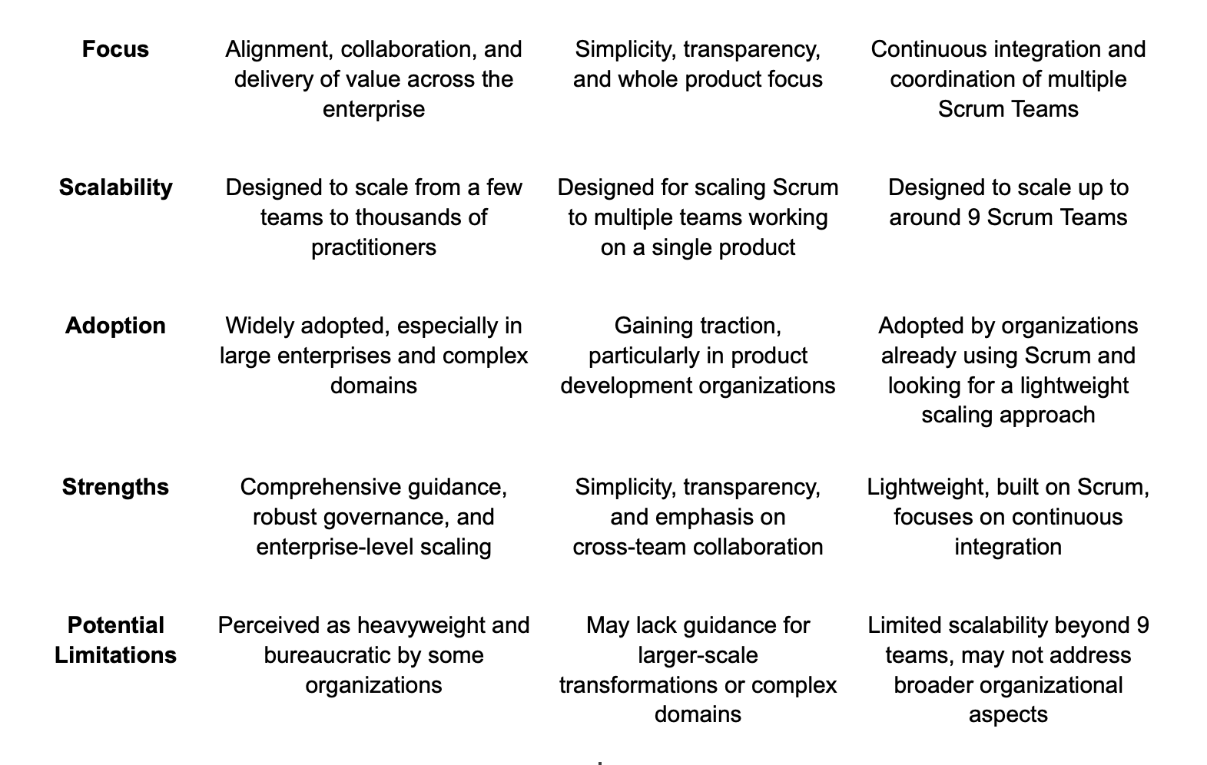

Slide 63
Comparative Analysis:
Each scaling framework has its strengths and weaknesses, and the choice depends on the organization's size, culture, and specific needs.
SAFe
LeSS
Nexus
Comprehensive and prescriptive, suitable for large enterprises with complex value streams. However, it can be perceived as heavyweight and bureaucratic.
Lightweight and focused on simplicity, suitable for organizations that value transparency and whole product focus. However, it may lack guidance for larger-scale transformations.
Designed specifically for scaling Scrum, suitable for organizations already using Scrum and looking for a lightweight scaling approach. However, it may not address the broader organizational aspects of scaling.

Slide 64
Measuring Success in Agile Projects
Measuring the success of scaled Agile implementations is crucial to ensure continuous improvement and alignment with organizational goals.
Project Velocity
Team Performance
Rate at which user stories are completed per sprint.
Collaboration, communication, morale
Product Quality
Business Outcomes
Measured by defect rates and user satisfaction surveys
Revenue growth, cost reduction, customer satisfaction
Notes:
Speaker Notes:
In Agile environments, measuring success goes beyond traditional project management metrics. Here's why focusing on these key aspects is crucial:
Project Velocity: Tracks the team's ability to deliver value through completed user stories per sprint. It helps identify trends, forecast future work, and improve efficiency.
Product Quality: Ensuring a high-quality product is paramount. Low defect rates and positive user satisfaction surveys indicate a product that meets user needs and expectations.
Team Performance: Effective collaboration, communication, and high morale are essential for Agile teams. Team members who work well together are more productive and produce better results.
Business Outcomes: Ultimately, Agile projects aim to deliver business value. Tracking metrics like revenue growth, cost reduction, and customer satisfaction helps demonstrate the positive impact of Agile practices on the organization's success.
By measuring and analyzing these aspects, we gain valuable insights into the effectiveness of our Agile implementation and can continuously improve our processes to achieve optimal outcomes.

Slide 65
06
Comparing Agile and other frameworks

Slide 66
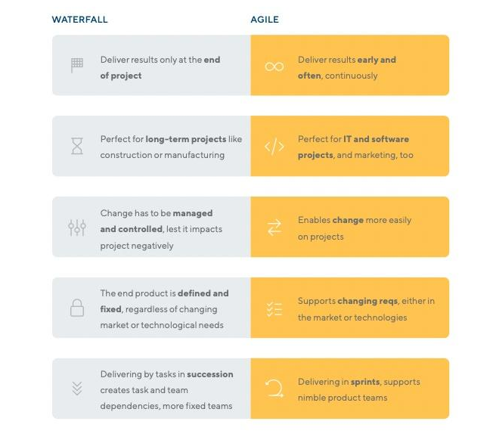
Comparing Agile with Other Frameworks
Agile vs Waterfall :
Key Differences and Advantages
Agile:
Iterative and Incremental Approach
Emphasis on Adaptability and Flexibility
Customer Collaboration and Feedback
Waterfall:
Sequential Phases: Requirements, Design, Implementation, Testing, Deployment
Limited Flexibility for Change
Comprehensive Planning upfront
Advantages of Agile Over Waterfall:
Faster Time-to-Market
Improved Stakeholder Collaboration
Better Responsiveness to Change
Notes:
While Agile methodologies, such as Scrum and Kanban, are widely adopted for software development, it's essential to compare them with other project management frameworks to understand their strengths and limitations.

Slide 67
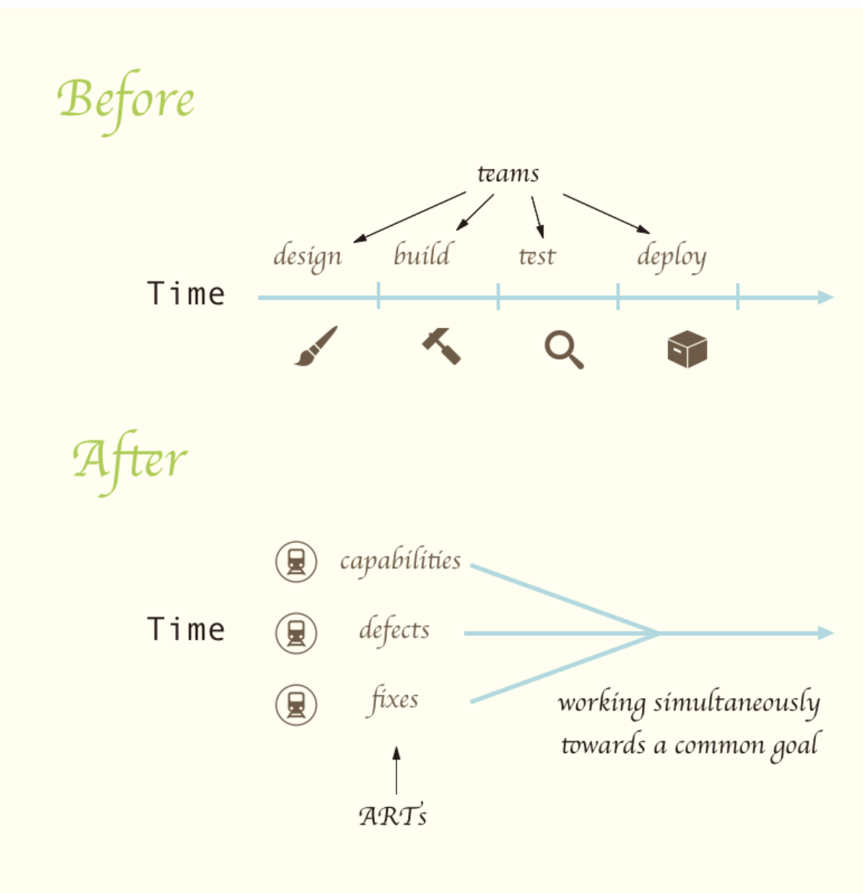
Case Study : Cisco (SAFe)
Cisco's Subscription Billing Platform struggled with the Waterfall method.
Frequent missed deadlines and defects.
Overtime for employees.
In 2015, they switched to the SAFe (Scaled Agile Framework) methodology.
Created 3 Agile Release Trains (ARTs) - cross-functional teams.
Daily stand-up meetings for transparency and accountability.
Incorporated Scrum and Extreme Programming (XP) practices.
Results:
40% decrease in critical defects.
16% decrease in defect rejection rate.
14% improvement in defect removal efficiency.
On-time delivery and no more overtime.
Agile/SAFe can improve development speed, quality, and employee satisfaction.

Slide 68

Comparing Agile with Other Frameworks
Agile vs DevOps :
Synergies and Collaboration
Agile :
Iterative Development
Customer Collaboration
Adaptive Planning
DevOps :
Automation
Continuous Integration & Delivery
Collaboration between Development and Operations
Integration of Agile and DevOps :
Streamlining Development Processes
Faster Delivery with Automated Testing and Deployment
Improved Quality and Reliability

Slide 69

Comparing Agile with Other Frameworks
Agile vs Lean :
Principles and Practices
Agile :
Adaptive Planning
Iterative Delivery
Customer Collaboration
Lean :
Minimizing Waste
Maximizing Value
Continuous Improvement
Integration of Agile and Lean :
Applying Lean Principles within Agile Frameworks
Examples: Kanban, Value Stream Mapping
Enhancing Workflow Efficiency and Customer Value
Notes:
When choosing a framework, organizations should consider their culture, project complexity, team skills, and overall business objectives. Agile methodologies excel in rapidly changing environments and prioritize customer collaboration and frequent delivery of working software. However, other frameworks may be more suitable for projects with strict regulatory requirements or well-defined, unchanging scopes.

Slide 70
07
Final Thoughts and Key Takeaways

Slide 71
Key Takeaways
Flexibility & Adaptability: Respond quickly to change.
Iterative Delivery: Continuous feedback & improvement.
Collaboration & Communication: Foster shared understanding.
Value-Centric Approach: Deliver value early & often.
Empowered Teams: Ownership & accountability.
Continuous Improvement: Reflect, adapt, optimize.
Measurable Outcomes: Track progress, make data-driven decisions.
Scaling & Alignment: Align teams with organizational goals.
Embracing Change: Adapt to evolving requirements & technology.
Cultural Shift: Embrace collaboration, transparency, & experimentation.
Notes:
Sej

Slide 72
References
https://revstarconsulting.com/blog/5-key-principles-of-agile-methodology-and-how-to-apply-them
https://www.slideshare.net/slideshow/agile-framework/1251231
https://www.slideshare.net/knoldus/introduction-to-agile-39907334
https://www.nimblework.com/agile/scrum-methodology/
https://www.planview.com/resources/guide/introduction-to-kanban/what-is-kanban-board/
https://www.objectstyle.com/blog/scaled-agile-success-story-lessons
https://bluebik.com/blogs/7370#
https://www.alexanderjsingleton.com/google-adwords-the-art-of-scrum-quintuple-constraint/
https://www.workplace.com/blog/agile-collaboration
https://www.wrike.com/agile-guide/benefits-of-agile/
https://lucid.co/blog/agile-implementation-challenges
Notes:
Sej

Slide 73
https://bluebik.com/blogs/7370#
https://www.techtarget.com/searchcio/definition/Agile-Manifesto
https://www.agilealliance.org/agile101/12-principles-behind-the-agile-manifesto/
https://www.productplan.com/glossary/agile-values/
https://www.productplan.com/glossary/agile-manifesto/
https://www.knowledgehut.com/blog/agile/agile-strategy
https://semaphoreci.com/blog/strategies-agile-implementation
https://businessagility.institute/learn/agile-strategy/314
https://bluebik.com/blogs/7370#
https://www.workplace.com/blog/agile-collaboration
https://kissflow.com/project/agile/benefits-of-burndown-charts/#:~:text=In%20agile%20projects%2C%20burndown%20charts,how%20much%20work%20is%20left.
Notes:
Sej

Slide 74
https://www.wrike.com/agile-guide/benefits-of-agile/
https://lucid.co/blog/agile-implementation-challenges
https://www.knowledgehut.com/blog/agile/best-agile-practices-distributed-teams#agile-best-practices-for-global-teams%C2%A0
https://www.planview.com/resources/guide/agile-methodologies-a-beginners-guide/agile-best-practices-effective-teams/
https://hbr.org/2016/05/embracing-agile
https://www.boost.co.nz/blog/2022/05/agile-for-non-software-teams
https://medium.com/agileinsider/agile-project-management-in-non-software-projects-b93ae63c598f#:~:text=Agile%20project%20management%20is%20a,%2C%20flexibility%2C%20and%20customer%20satisfaction.
https://fastercapital.com/content/The-Art-of-Agile-Project-Management-in-Development.html
https://www.infoq.com/presentations/Agile-Management-Google-Jeff-Sutherland/
https://www.linkedin.com/pulse/google-pioneering-innovation-agile-methodologies-david-mccreery-qax8e/
https://www.alexanderjsingleton.com/google-adwords-the-art-of-scrum-quintuple-constraint/
Notes:
Sej

Slide 75
THANK YOU !

